Slide 1





SOUTH ASIAN WOMEN AND THE STIGMA OF REPORTING IPV

Slide 2




Team Members
Karm Grewal - Melissa Umali - Surleen Shoker
Land Acknowledgement
We acknowledge that we have the privilege of living, learning, and playing on the unceded and traditional territories of the Coast Salish and Tsawwassen Peoples
Notes:
Hi everyone, we are Melissa, Surleen, and Karm. We are here to give you a presentation on South Asian Women and the Stigma of Reporting Intimate Partner Violence.
-
We acknowledge that we made this presentation, and that we live, learn, and play on the unceded and traditional lands of the Coast Salish and Tsawwassen Peoples.

Slide 3
Introduction
Topic:
Addressing the stigma and lack of reporting of intimate partner violence among South Asian women in Surrey, British Columbia
Presentation Outline:
Problem Description
Solution: Initial ED Screening and Assessment
Solution 2: Community Outreach in Cultural and Religious Centers
Solution 3: Public Awareness Campaign
Conclusion
Notes:
The wicked problem we chose is the stigma and lack of reporting of intimate partner violence among South Asian women in Surrey, BC. Given that two of us are of South Asian descent, two of us work at Surrey Memorial, and all three of us live within this community, we saw this as a problem that needed to be addressed.
This presentation will start with a brief overview of the wicked problem itself, before delving deeper into the three solutions we came up with to start tackling the problem. Solution 1 revolves around the initial ED Screening and Assessment process at Surrey Memorial Hospital and will be presented by Melissa. Solution 2 is reaching out into the community in cultural and religious centers, presented by Surleen. Lastly, Karm will be presenting on a Public Awareness Campaign. We will finish this presentation by summarizing the solutions and going over what we believe is our most feasible solution.

Slide 4

Background
Intimate Partner Violence is any physical, sexual or psychological harm caused by an intimate partner.
South Asian women includes women from India, Nepal, Pakistan, Sri Lanka, Afghanistan, Bangladesh, and the Maldives
(World Health Organization, 2024; Baloch et Al., 2025; Tasbiha & Zaidi, 2023)
Notes:
Intimate partner violence is a global public health concern. It includes physical, sexual, or psychological harm that is inflicted by an intimate partner. South Asian women encompass people who come from India, Nepal, Pakistan, Sri Lanka, Afghanistan, Bangladesh, and the Maldives. These women are diverse, with many different languages and traditions, however they often share the same cultural values. South Asian women face a cross section of identities that increases their risk of experiencing IPV. In our research, we found that 30-50% of South Asian women will experience some form of IPV in their lifetimes.

Slide 5
Cultural Norms
1
Barriers for South Asian Women Experiencing IPV
Patriarchy, family honour, collectivism
Shame, blame, social isolation
Social Pressure
2
Divorce as a cultural failure
Not alone when meeting with health care providers
Socioeconomic Status
3
Many are immigrants or children of immigrants
Language barriers
Financial dependence
(Baloch & el., 2025; Tasbiha & Zaidi, 2023; Marugan et al., 2023; Surrey Local Immigration Partnership, 2025)
Notes:
South Asian women face challenges that are unique to their culture and background when experiencing intimate partner violence. Cultural norms, such as patriarchy and family honour, discourage reporting any abuse they may face. Simply even reporting an abusive partner, let alone leaving them entirely, can result in strong feelings of shame, blame, and isolation. This fear of dishonouring the family may prevent disclosure.
The South Asian community also may see any divorce or separation as a personal or cultural failure. Further, partners or other family members (usually the mother-in-law) are often present in healthcare settings due to social norms or possibly an intentional act to suppress expression of concerns, which can also further perpetuate feelings of embarrassment, guilt, and shame.
Lastly, the socioeconomic status of South Asian women in Surrey plays a large role in reporting IPV. Many South Asians in Surrey are immigrants or children of immigrants, as 45% of Surrey’s population are in fact immigrants. South Asian women are more likely to experience immigration related challenges as they may be dependent on their spouses for finances, housing, and legal status. These women may experience language barriers as well and may have limited familiarity with the system in place that are meant to help them, which further increases their vulnerability).
These concepts of cultural norms, social pressures, and socioeconomic status show how intimate partner violence in the South Asian community, and for our purposes specifically in Surrey, presents us with a complex, challenging, and ongoing issue, thus meeting the criteria for a wicked problem.

Slide 6

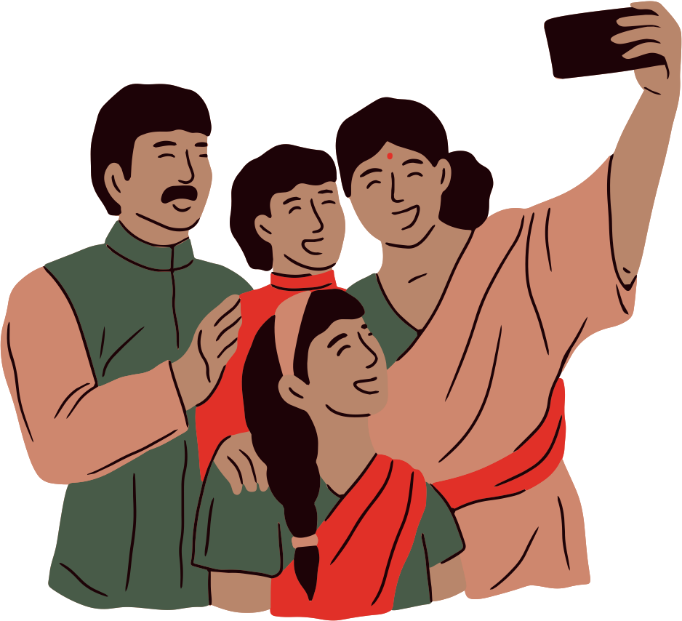

Initial ED Screening and Assessment
Community Outreach in Cultural and Religious Centers
Solutions
Public Awareness Campaign
(Mughal & Arnault, 2024)
Notes:
Research examining IPV in the South Asian context is limited and there is minimal exploration into avenues to tackle this problem. Therefore, we have come up with the following three solutions to hopefully lower the stigma of reporting IPV in Surrey’s South Asian community. these solutions are initial ED screening and assessment, community outreach in cultural and religious centers, and a public awareness campaign.

Slide 7
Solution 2:
Community Outreach in Cultural and Religious Centres
Presented by Surleen Shoker
Notes:
Hi everyone, I’ll be discussing our second solution Community Outreach in Cultural and Religious Centres

Slide 8




Partnership & Outreach
Partner with Religious and Cultural Leaders
Set up booth and hosting talks at key community and religious centres
HCPs with specialized training in providing culturally informed IPV education and support
Utilize existing materials related to resources and community supports
Connect stakeholders
(Baloch et al., 2025; Mughal & Arnault, 2024)
Notes:
Cultural awareness and understanding of IPV as discussed stands as a major hindrances to addressing domestic violence that occurs in the South Asian Community.
Thus, shifting the broader cultural attitude is an essential step in tackling this wicked problem.
This solution would involve setting up booths and hosting talks at cultural and religious centres in partnership with local leadership and organizations to provide materials and resources on IPV and DV that are culturally sensitive and appropriate, directly to community members.
Cultural and religious centres may include Temples, Gurdwaras, Mandirs, Mosques, and Churches.
Health care providers such as nurses, social workers or community outreach worker with specialized training in IPV would host these booths. They would engage with community members providing information on IPV with a culturally informed lens.
Direct community awareness efforts are especially helpful since very few resources are available in languages other than English, such as Punjabi and Hindi. Ideally, the HCP would speak the predominant language spoken in that specific community to help decrease the language barrier.
These interactions also provide the opportunity to model how technologies can be used to translate materials. For example, using the Google image translate feature. This is a very simple way to tackle language barriers and increasing self efficacy.
The booths would be organized in partnership with the existing community resources available in Surrey. Such as the Fraser Health Embrace Clinic, Surrey Women’s Centre and Options Community Services to name a few. The resource materials provided would be comprised of information already linked to theses community organizations. Thus allowing increased visibility of these organizations beyond their typical advertising.
Often South Asian women are not aware of local resources and are unsure how to navigate a new complex healthcare and legal system as new immigrants. So having easy access to a liaison is very beneficial in simplifying a complex web of resources that likely do not exist in their country of origin.
Due to the intersectional nature of IPV experienced by South Asian Women, they often need resources beyond those typically offered by domestic violence prevention and intervention organizations.
South Asian Women need a more holistic array of
resources including those related to housing, immigration, finances, healthy living, education, employment, parenting, and legal services. So these types of resources would also be highlighted in this outreach program.

Slide 9




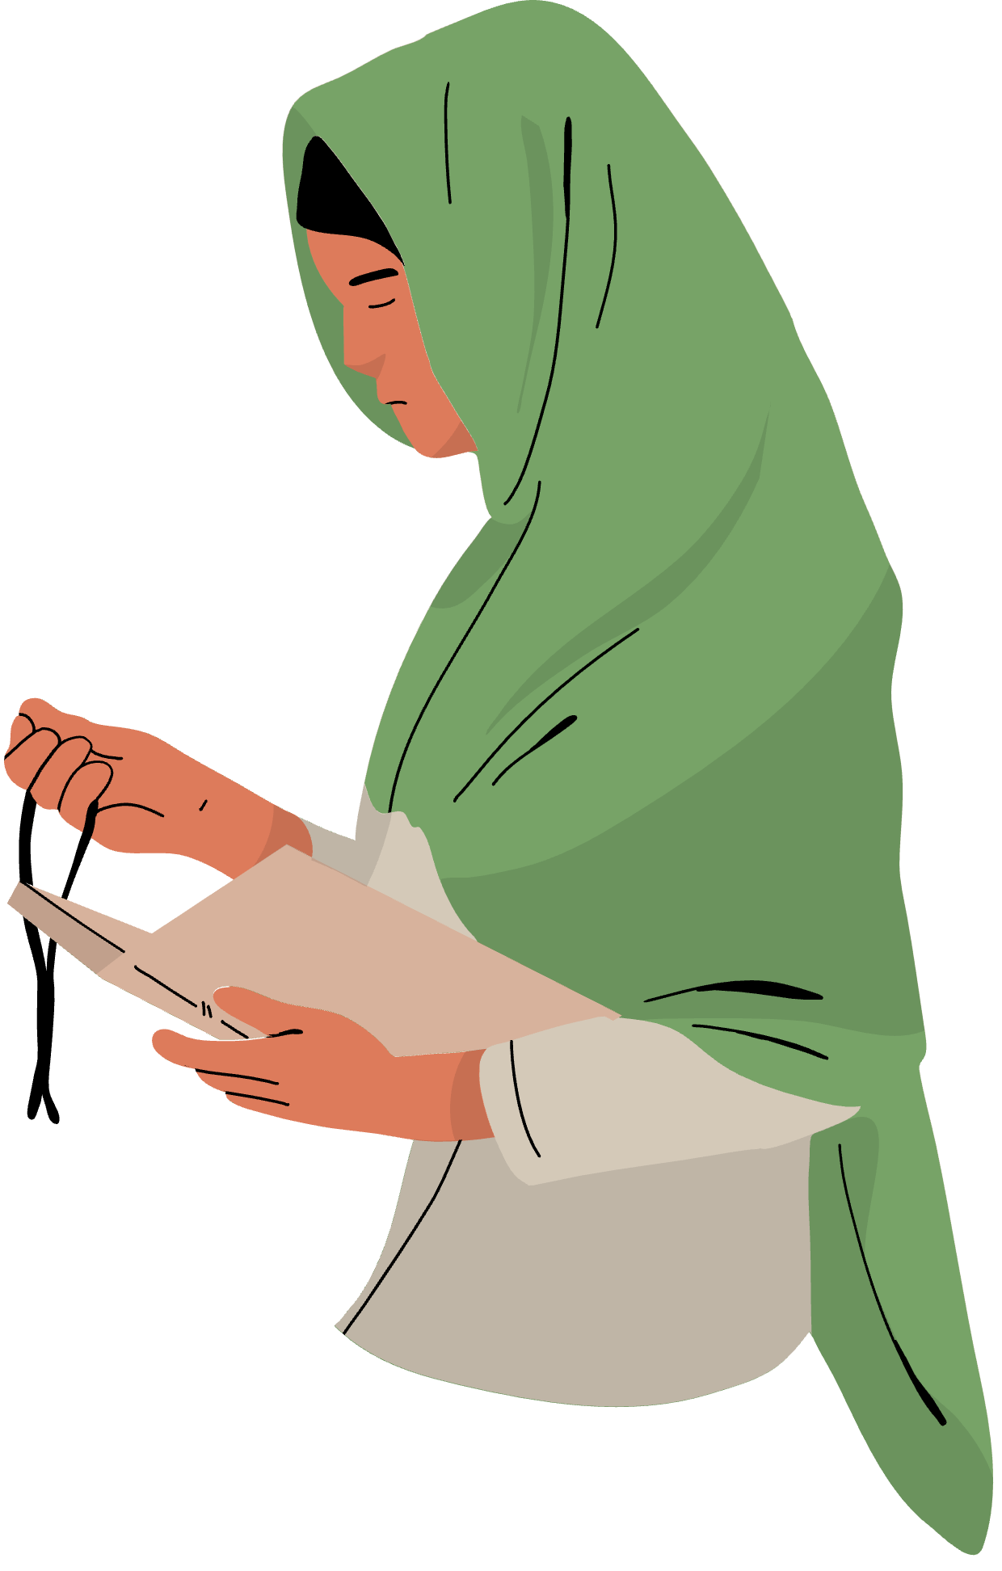


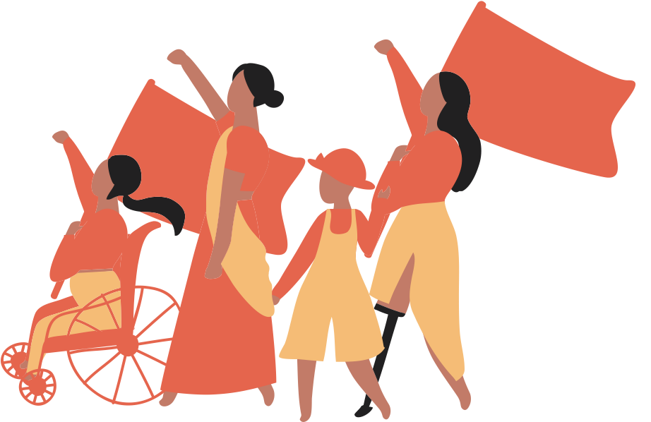
Strengths
Emotional and Spirtual Healing
Partnership
Kinship Network
Resource Management
Ahmad-Stout et al., 2018; Bhandari, 2017; (Istratii et al., 2024; Mahapatra & Rai, 2019; Mughal & Arnault, 2024; Pio & Moore, 2021
Notes:
There are several strengths to this solution:
Religious centers are often the few spaces in which very insulated women may be able to participate in freely. They are often cited as a source of spiritual support and comfort when coping with abuse.
This solution also leverages the significance of cultural leaders and centres on the South Asian Community to induce change in the overall cultural stigma around IPV. It presents a novel way to introduce a public awareness campaign with a community-centered approach in mind.
The leaders in these spaces hold a strong influence on the values, beliefs and opinions of their communities. Creating partnerships with these leaders not only allows for a top down flow of information but a reciprocal transfer of community concerns and perspectives through their chosen leadership.
Outreach booths and community education at key cultural centres targets a wide range of people in addition to the women experiencing abuse.
Thus, additionally educating the ‘kinship network’; family, friends or coworkers that support women in leaving abusive situations.
This increases the social impact of this intervention through bystander training. Often women experiencing abuse, may seek out informal support through trusted friends and coworkers prior to reaching out to formal supports. Under the current, cultural understanding of abuse, these informal support systems may not appropriately advise women that they are in an unsafe situation. They may instead council women to stay in these abusive relationships to preserve family honour.
So creating a more informed informal support system is significant benefit of this solution.
An effective kinship network has been shown to facilitating a pathway for women to access formal support.
Many organizations lack insight into the needs of South Asian women experiencing violence at home. Especially those catering to the general public.
The team running this solution is well positioned to advocate for the needs of South Asian Women with a bottom up approach to larger organizations and address gaps in programming.
Siloed care across organizations is a commonly cited concern which may be mitigated through the communication and collaboration required by this intervention.
In addition resources maybe better managed as individuals seeking care are appropriately directed to the services that would best address their needs and have the capacity to support them. Leading to decreased frustration and loss of confidence in the system.

Slide 10

Challenges
Funding.
Finding staff to run the booths that are well versed in the required cultural knowledge and background along with providing education IPV.
While religion is a source of comfort, Religious leaders may echo cultural stigma and perpetuate harm. Therefore it maybe difficult to find supportive spaces And community leaders.
Organizational support and communication
(Aujla, 2020; Istratii et al., 2024; George et al., 2022; Park et al., 2021; Pringle et al., 2022; Rai, 2020; Turin et al., 2021; Yakubovich et al., 2023)
Notes:
One of the biggest challenges is always is funding. As we living through uncertain economic times we see that funding for community supports is threatened. Which is a significant concern. In 2023, the federal government made funding commitments to a national action plan to address violence against women. This indicates some political momentum in this area. Thus this could be a source of funding.
The primary financial and practical barrier associated with this solution would be related to staffing the team, as multiple people would be required to meet the experiential, language and cultural requirements to serve a diverse community.
Research has shown that while religion is a key source of comfort to South Asian Women when coping with abuse. Religious or Cultural leaders as informal support systems often perpetuate cultural norms around family, gender and responsibility. Thus, they may provide counsel that keeps women silenced and trapped in their abusive situations.
Fostering collaboration across multiple organizations is also a significant challenge. While primary services are provided through Fraser Health. Many of the culturally specific services are smaller non-profit organizations. For this reason support services vastly differ in their capacity, motivations and incentives to collaborate in this solution. Which leads into our conversation about feasibility.

Slide 11



Understanding Community Needs and Prioritise
Facilitating Partnership and Collaboration
Community Funding
Feasability
Resource Network
Model Services
(Aujla, 2020; Istratii et al., 2024; George et al., 2022; Park et al., 2021; Pringle et al., 2022; Rai, 2020; Turin et al., 2021; Yakubovich et al., 2023)
Notes:
The feasibility of this solution is very dependent on how well local organization are able to share information and collaboration to provide culturally informed care. At the same time relying on existing services decreases the burden of building a service that holistically meets all the needs of South Asian Women. Culturally informed services also have a higher rate of participation by South Asian Women.
Although there are some collaborative relationships already established such as that between the Embrace Clinic and the Surrey Women’s Centre. Due to the number of supports needed by South Asian Women to leave abusive situations. The relationship building set of this solution would be likely the most labour intensive aspect. While this does decrease the feasibility of this solution, forming these relationship also resolves the significant problem of siloed care which was highlighted in the national action plan recommendations.
One way that the feasibility of this solution could be supported is through community funding by the partnered cultural and religious institutions. Often these institution engaging in community funding activities. So expansion of the program and locations could be achieved in this way.
In regards to the challenge of cultural stigma by religious leaders. Strong relationships need to be fostered and community concerns need to be understood. This could involve posing the problem from a healthy families perspective, discussing the impact on children and acknowledging how immigration and socioeconomic inequalities foster conditions that can lead to violence in the home. This change in perspective may increase buy in by better reflecting community priorities. With continued partnership cultural leaders may also have a change in thinking about IPV. There are some educational programs specifically designed to educate religious leaders on IPV but this would be beyond the scope of this solution.
Community based programs that use a cultural and intersectional approach have been employed in other places across Canada so there are existing models that can be replicated and used to guide development, as well as anticipate community needs. As well as to market feasibility and create buy-in from stakeholders.

Slide 12


Conclusion
Solution 1: Initial ED Screening and Assessment
This solution focuses on implementing simple but powerful changes to how we conduct our emergency department intake and assessments.
Solution 2: Community Outreach in Cultural and Religious Centres
Providing direct community outreach and awareness at booths set up in key cultural and religious centres
Solution 3: Public Awareness Campaign
Using South Asian media outlets and restaurants/stores to enhance awareness into how IPV is a community and social problem, not a private one
Notes:
In summary, the three solutions we have come up with in tackling the wicked problem of the stigma and lack of reporting of Intimate Partner Violence in Surrey’s South Asian women are: Initial ED Screening and Assessment tools, community outreach in cultural and religious centres, and a public awareness campaign. All three solutions are strong, in that they will get the conversations we need started to start reducing the stigma and hopefully increase reporting of these incidents. Solution 1 focuses on simple and powerful changes on how the ED conducts their intake and assessments. This solutions strength comes from it's culturally aware approach, and it's ability to try and normalize IPV screening as a part of everyday assessment, and not something that gets buried away. It allows for a private and safe space for women to speak up.
Solution 2 would provide direct community outreach and awareness in key cultural and religious centers. This solution is strong because these centers are one of the few places where these women can freely participate. This solution leverages leaders in the South Asian community to partner with these women in a top-down approach to communicate important information. (Add more from strengths here also)
and solution 3 would use south Asian media outlets and restaurants and stores to enhance awareness into how IPV is a community and social problem, not a private one. This solution uses the concept of message reinforcement to spread information across our targeted population. It would help in shifting thinkings and attitudes towards South Asian women who experience IPV.
While all of these solutions would work best in tandem and have their own strengths, we believe that there is a single solution that is the most feasible at this time.

Slide 13

What can we achieve currently?
Minor changes to existing protocols
Area of change is more localized, less individuals involved to adapt to changes
Does not require change in deeply held cultural values, norms and beliefs
Measurable outcomes
Allows insight into the issue as it stands in the community
Solution 1
Notes:
Solution 1 is the intervention that we believe will be the most feasibility to implement at this time. This solution presents the least amount of challenges to implementation. Unlike Solution 2 and 3 which both require greater community and stakeholder investment. Solution 1 has a smaller focus on just the SMH ER. While this maybe less impactful in the long term it provides the opportunity to gain better initial insights into the scope of the issues. It allows for screening of community needs and shows measurable outcome earlier on. This may then be used to provide evidence for the other 2 solutions to be applied later down the road.

Slide 14

Questions and Comments
Notes:
And now we will open it up for questions and comments, thank you everyone.

Slide 15
THANK YOU

Slide 16
References - Surleen
Ahmad-Stout, F., Nath, S. R., Khoury, N. M., & Huang, H. (2018). Experiences of intimate partner violence: findings from interviews with South Asian women in the United States. Journal of Interpersonal Violence, 36(3–4), NP1941-1964NP. https://doi.org/10.1177/0886260517753850
Aujla, W. (2020). “It was like Sugar-Coated words”: Revictimization when South Asian immigrant women disclose domestic violence. Affilia, 36(2), 182–203. https://doi.org/10.1177/0886109920916038
Baloch, S., McLindon, E., Hameed, M., & Hegarty, K. (2025). South Asian women’s lived experiences of health care after disclosure of family violence: a qualitative meta-synthesis review. BMC Public Health, 25(1). https://doi.org/10.1186/s12889-025-21619-5
Bhandari, S. (2017). South Asian women’s coping strategies in the face of domestic violence in the United States. Health Care for Women International, 39(2), 220–242. https://doi.org/10.1080/07399332.2017.1385615
Istratii, R., Ali, P., & Feder, G. (2024). Integration of religious beliefs and faith-based resources in domestic violence services to migrant and ethnic minority communities: A scoping review. Violence an International Journal, 5(1), 94–122. https://doi.org/10.1177/26330024241246810
George, P., Medhekar, A., Chaze, F., Osborne, B., Van Heer, M., & Alavi, H. (2022). In search of interdisciplinary, holistic and culturally informed services: The case of racialized immigrant women experiencing domestic violence in Ontario. Family Court Review, 60(3), 530–545. https://doi.org/10.1111/fcre.12653
Mahapatra, N., & Rai, A. (2019). Every cloud has a silver lining but. . . “pathways to seeking formal-help and South-Asian immigrant women survivors of intimate partner violence.” Health Care for Women International, 40(11), 1170–1196. https://doi.org/10.1080/07399332.2019.1641502
Mughal, F. B., & Arnault, D. S. (2024). Protective factors affecting trauma recovery among female South Asian immigrant intimate partner violence survivors: a scoping review. Trauma Violence & Abuse, 25(4), 2927–2941. https://doi.org/10.1177/15248380241231602
Park, T., Mullins, A., Zahir, N., Salami, B., Lasiuk, G., & Hegadoren, K. (2021). Domestic violence and immigrant women: A glimpse behind a veiled door. Violence Against Women, 27(15–16), 2910–2926. https://doi.org/10.1177/1077801220984174
Pio, E., & Moore, V. (2021). Battered South‐Asian diasporic women: Culture, secrets and work. Gender Work and Organization, 29(2), 536–560. https://doi.org/10.1111/gwao.12780
Pringle, W., Sachal, S. S., Dhutt, G. S., Kestler, M., Dubé, È., & Bettinger, J. A. (2022). Public health community engagement with Asian populations in British Columbia during COVID-19: towards a culture-centered approach. Canadian Journal of Public Health, 113(S1), 14–23. https://doi.org/10.17269/s41997-022-00699-5
Rai, A. (2020). Indirect experiences with domestic violence and help‐seeking preferences among south asian immigrants in the United States. Journal of Community Psychology, 49(6), 1983–2002. https://doi.org/10.1002/jcop.22492
Turin, T. C., Chowdhury, N., Haque, S., Rumana, N., Rahman, N., & Lasker, M. a. A. (2021). Meaningful and deep community engagement efforts for pragmatic research and beyond: engaging with an immigrant/racialised community on equitable access to care. BMJ Global Health, 6(8), e006370. https://doi.org/10.1136/bmjgh-2021-006370
Yakubovich, A. R., Steele, B., Moses, C., Tremblay, E., Arcenal, M., O’Campo, P., Mason, R., Du Mont, J., Huijbregts, M., Hough, L., Sim, A., & Shastri, P. (2023). Recommendations for Canada’s National Action Plan to End Gender-Based Violence: perspectives from leaders, service providers and survivors in Canada’s largest city during the COVID-19 pandemic. Health Promotion and Chronic Disease Prevention in Canada, 43(4), 155–170. https://doi.org/10.24095/hpcdp.43.4.01

