Slide 1
Reallocating Agency Funding to Strengthen Permanent Nurse Retention
The Impact of Agency Nurses on Staff Morale and Retention in Vancouver
A systems-level strategy to reduce agency dependence and improve staff morale & retention
Presented by Sarrah Welch

Slide 2
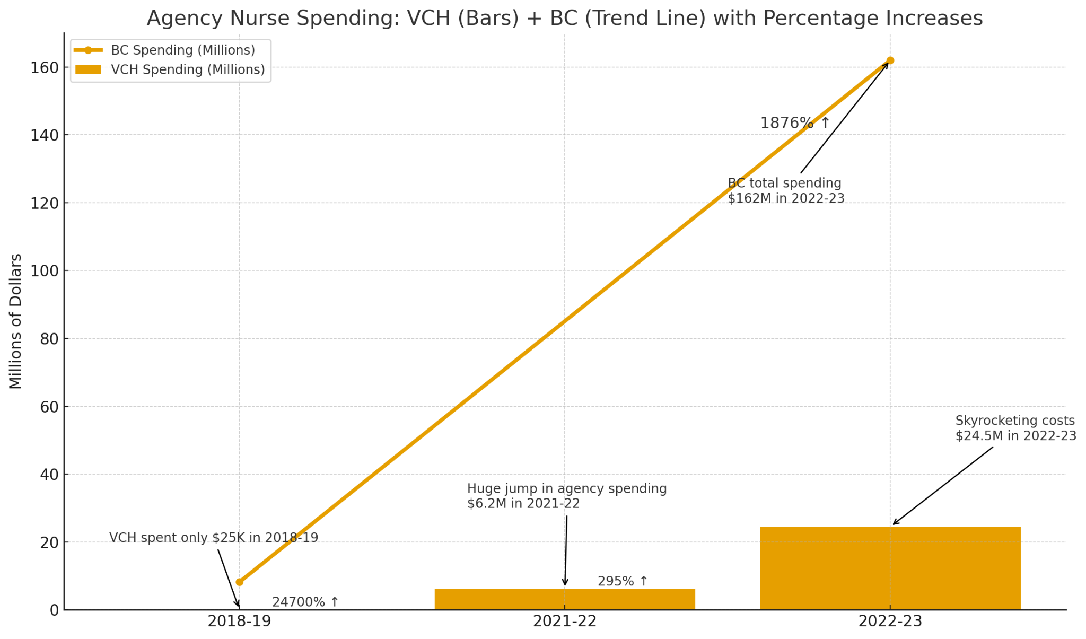
The Problem and Trends
(Almost, 2024;British Columbia Nurses' Union, 2025; Wilson, 2023)

Slide 3




What is currently being done in Vancouver and Vancouver Coastal Health?
Relocation Assistance for new hires
Signing bonuses up to $15,000
Registration fee reimbursement
NO ongoing retention incentives
(Almost, 2024;British Columbia Nurses' Union, 2024;Schuermann, 2025)

Slide 4
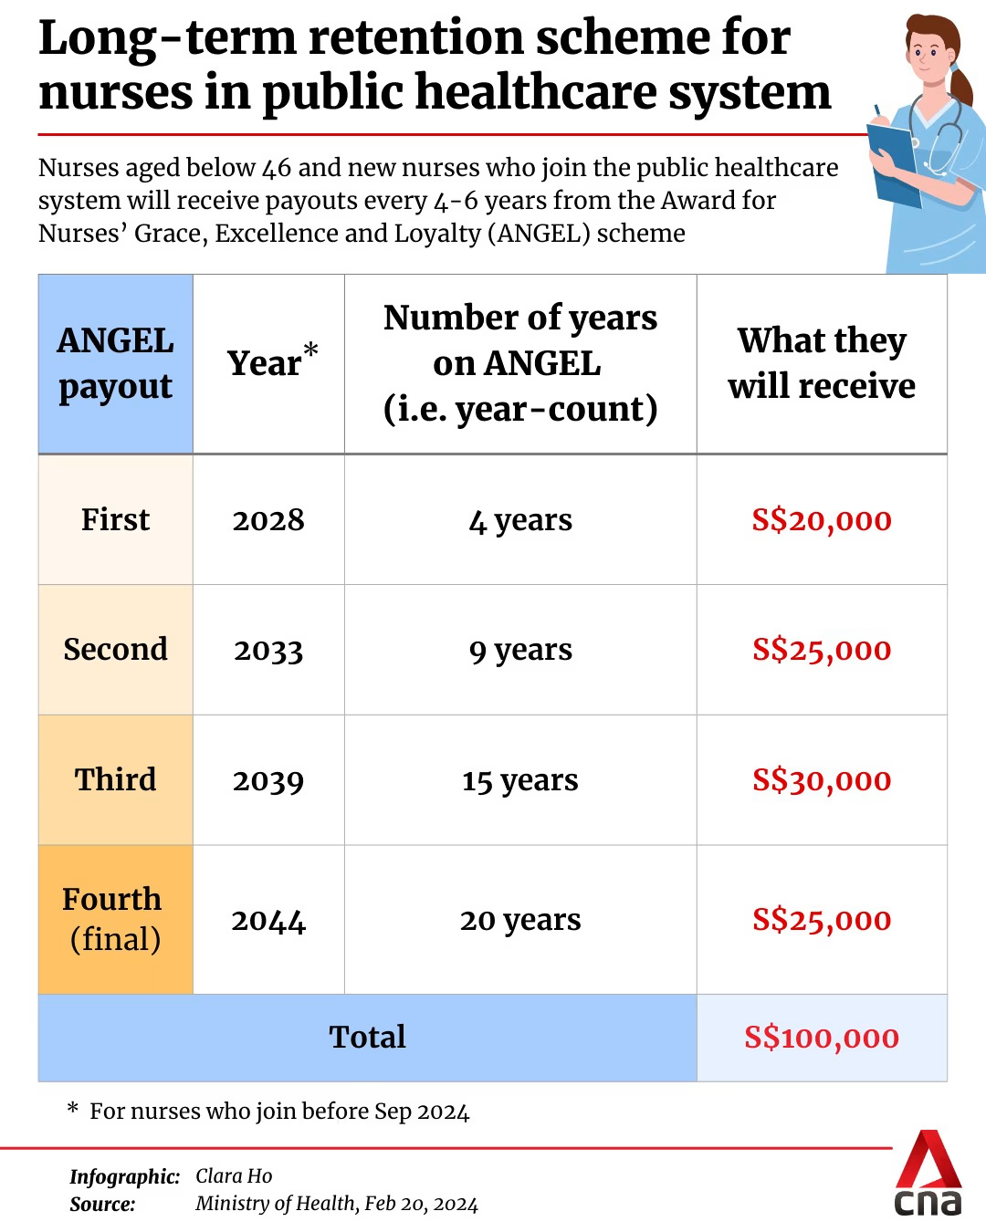
Solution: Retention Bonuses
Each nurse can receive up to S$100,000 over 20 years, or up to the prevailing retirement age
Nurses 46+ with ≥5 years of service receive an immediate S$5,000–S$15,000 award.
Afterwards, they follow an accelerated payout schedule: S$15,000 every 3 years.
Designed to recognize and reward long-serving nurses.
Eligible nurses on post-retirement contracts will also receive the one-off recognition payout if they have at least five years in service
(Ministry of Health Singapore, 2024)

Slide 5

Solution: Retention Bonuses
What PRRI Provides
Up to $2,000 per quarter (max $8,000 annually)
Pro-rated based on productive hours
For permanent RNs, RPNs, and LPNs
Where PRRI Applies
Targets rural and remote communities in BC
Now supports 75 communities in total
Limitation: Time-limited incentives can create a ‘revolving door
The Gap in Vancouver
PRRI does not apply to urban Vancouver facilities
No equivalent urban retention incentive exists
(British Columbia Nurses' Union, 2024a;British Columbia Nurses' Union, 2024b)

Slide 6

Solution: Retention Bonuses
Quarterly Pro-rated retention payments similar to PRRI (e.g., up to $2,000 per quarter)
Pro-rated Milestone bonuses every 4–5 years, modeled after ANGEL
Immediate recognition bonuses for long-serving nurses
Eligibility for new grads and nurses new to VCH including previously employed agency nurses to join the VURI initiative
Like ANGEL and PRRI, the goal is to make permanent positions financially competitive, improve morale, and rebuild workforce stability while emphasizing it as a long term initiative
(British Columbia Nurses' Union, 2024a;British Columbia Nurses' Union, 2024b; Ministry of Health Singapore, 2024)

Slide 7
VURI: Rationale
Strengthens morale by:
Reducing the financial gap between permanent and agency nurses
Creating a sense of long-term security and belonging
Rewarding commitment and service longevity
Supporting stability within teams, which reduces burnout and improves working relationships
Creating predictable staffing levels, lowering overtime pressure
Strengths of VURI:
Builds internal loyalty instead of paying external agencies
Supports team cohesion and continuity of care
Makes Vancouver more livable for permanent staff
Encourages nurses to stay beyond the initial recruitment period
Creates a stable, permanent workforce that reduces turnover-driven stress
(Almost, 2024;British Columbia Nurses' Union, 2024b;British Columbia Nurses' Union, 2025;Healthcare Excellence Canada, 2025)

Slide 8
Implementation Plan
(British Columbia Nurses' Union, 2024; Ministry of Health Singapore, 2024; National Assembly of Quebec, 2023)
PHASE 1 Immediate 0-6 months
PHASE 2 Short Term 6–12 Months
PHASE 3 Medium Term 12–24 Months
PHASE 4 Long Term 24+ Months
Future
Foundation & Policy Direction
Announce intent to reduce for-profit agency reliance (Quebec model)
Continue using recruitment incentives (sign-on, relocation) to attract nurses.
Begin planning for fund reallocation toward retention bonuses
Preparation & Infrastructure
Develop the structure of VURI
Adapt PRRI payment mechanisms (productive-hours tracking)
Create central oversight team to monitor agency reduction
Announce plan for VURI
Implementation & Agency Phase-Out
Quebec-style targeted phase-out of agency nurses in the initial high-agency units.
Launch a 6-month VURI pilot in these same units.
Redirect former agency funds into sustained retention incentives.
Track recruitment success + VURI retention rates
Evaluation, Expansion
Evaluate the current rollout
Adjust VURI payout structure as needed
Expand the program to other units if successful
Continue reducing agency use until full transition to permanent staffing is achieved
System Stabilization and Future Directions
Continue to evaluate VURI
Complete ban on for profit nursing agencies
Adequate staffing is achieved and maintained for Vancouver

Slide 9

Challenges
(BC Public Service, 2025;Healthcare Excellence Canada, 2025;National Assembly of Quebec, 2023)
1
2
3
4
Political & Policy Challenges in BC
Legal Considerations
Workforce & Stakeholder Concerns
Operational & Administrative Challenges
New tracking + payroll processes needed
Temporary strain on high-agency units
Requires coordination across teams
BC’s policymaking is slow and consultative
Need provincial approval + BCNU alignment
Possible resistance to reallocating funds
Quebec’s Bill 10 faces legal challenge
Concerns about patient access
BC must ensure a legally sound transition
Potential pushback from high-agency dependant units
Risk of short-term staffing gaps
Need strong buy-in from staff and leaders

Slide 10
Feasibility & Recommendations
(British Columbia Nurses' Union, 2024b;GoHealthBC, 2025;Healthcare Excellence Canada, 2025;National Assembly of Quebec, 2023)
1
2
3
4
Financial Feasibility
Administrative Feasibility
Operational & Political Feasibility
Labour Relations & Oversight Feasibility
Funded through existing agency spending (VCH $24M+, BC $162M)
Savings increase as agency use declines
Quebec’s Bill 10 shows this model is financially realistic
PRRI systems already in place
Payroll can track productive hours
Easy integration into existing processes
GoHealth BC can replace agency shifts during transition
Phased rollout lowers risk
Pilot builds early success
Aligned with Quebec’s staged model
Recruitment incentives already improving staffing
Collaboration with BCNU supports adoption
Oversight ensures compliance
Early evaluation maintains safety

Slide 11
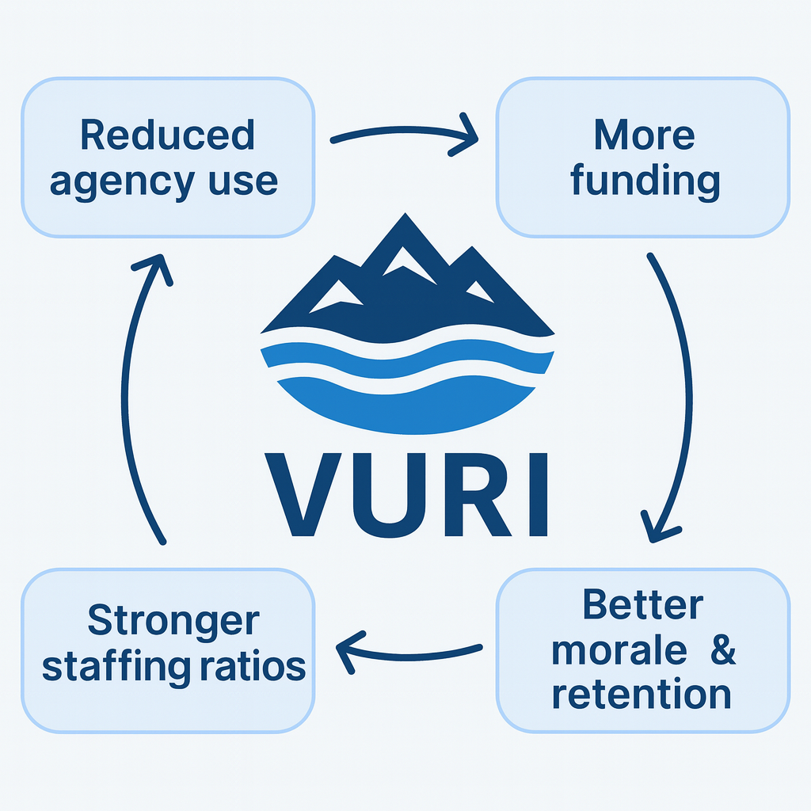
Conclusion
Why It Works
Redirects agency spending into permanent staff
Strengthens financial incentives for retention
Builds long-term workforce stability
Systems Impact
Less agency use → more savings → more retention funding → stronger staffing → better morale & cohesion
Overall Effect
Makes permanent roles more attractive
Improves morale and team stability
Helps address the wicked problem tied to agency reliance
(British Columbia Nurses' Union, 2024b;Healthcare Excellence Canada, 2025;Rutter et al., 2017)

Slide 12
References
Almost, J. (2024). Opening the black box: Unpacking the use of nursing agencies in Canada. Canadian Federation of Nurses Unions. https://nursesunions.ca/wp-content/uploads/2024/09/Agency-Full-Report-Final-English-20Sept2024.pdf
BC Public Service. (2025, July 25). Government 101: How Government Works - Province of British Columbia. Www2.Gov.bc.ca. https://www2.gov.bc.ca/gov/content/careers-myhr/about-the-bc-public-service/how-government-works
British Columbia Nurses' Union. (2024a). Staffing Incentives Help Make Minimum Nurse-to-Patient Ratios a Reality | BC Nurses’ Union. Bcnu.org. https://www.bcnu.org/news-and-events/news/2024/staffing-incentives-help-make-minimum-nurse-patient-ratios-reality
British Columbia Nurses' Union. (2024b, April 5). Nurse Recruitment and Retention Incentives:Health Workforce Planning and Implementation. https://www.bcnu.org/files/MOU_mNPR_Nurse_Recruitment_and_Retention_Incentives_-_April%202024
British Columbia Nurses' Union. (2025, March 27). For Patients, Not Profit | BC Nurses’ Union. Bcnu.org. https://www.bcnu.org/news-and-events/update-magazine/2025/spring-2025/for-patients-not-profit

Slide 13
References
GoHealthBC. (2025). About GoHealth BC | GoHealth BC. Gohealthbc.ca. https://gohealthbc.ca/why-join-gohealth-bc/about-gohealth-bc
Healthcare Excellence Canada. (2025). Policy Considerations: Optimizing the Use of Staffing Agencies in the Health System. https://www.healthcareexcellence.ca/media/4ksjoqyg/agencystaffingreport-march-2025-en-final.pdf
Ministry of Health Singapore. (2024, February 20). LONG-TERM RETENTION SCHEME FOR NURSES IN PUBLIC HEALTHCARE. Ministry of Health. https://www.moh.gov.sg/newsroom/long-term-retention-scheme-for-nurses-in-public-healthcare/
National Assembly of Quebec. (2023). Bill 10 An Act limiting the use of personnel placement agencies’ services and independent labour in the health and social services sector. https://www.publicationsduquebec.gouv.qc.ca/fileadmin/Fichiers_client/lois_et_reglements/LoisAnnuelles/en/2023/2023C8A.PDF

Slide 14
References
Rutter, H., Savona, N., Glonti, K., Bibby, J., Cummins, S., Finegood, D. T., Greaves, F., Harper, L., Hawe, P., Moore, L., Petticrew, M., Rehfuess, E., Shiell, A., Thomas, J., & White, M. (2017). The Need for a Complex Systems Model of Evidence for Public Health. The Lancet, 390(10112), 2602–2604. https://doi.org/10.1016/s0140-6736(17)31267-9
Schuermann, J. (2025, August 7). Vancouver fourth most expensive city worldwide: report. CityNews Vancouver. https://vancouver.citynews.ca/2025/08/06/vancouver-fourth-most-expensive-city-worldwide-report/
Wilson, J. (2023, September 14). “Outrageous”: Expert criticizes rates paid in BC for-profit nursing firms. Hrreporter.com; Canadian HR Reporter. https://www.hrreporter.com/focus-areas/recruitment-and-staffing/outrageous-expert-criticizes-rates-paid-in-bc-for-profit-nursing-firms/379670

