Slide 1





SOUTH ASIAN WOMEN AND THE STIGMA OF REPORTING IPV

Slide 2




Team Members
Karm Grewal - Melissa Umali - Surleen Shoker
Land Acknowledgement
We acknowledge that we have the privilege of living, learning, and playing on the unceded and traditional territories of the Coast Salish and Tsawwassen Peoples
Notes:
Hi everyone, we are Melissa, Surleen, and Karm. We are here to give you a presentation on South Asian Women and the Stigma of Reporting Intimate Partner Violence.
-
We acknowledge that we made this presentation, and that we live, learn, and play on the unceded and traditional lands of the Coast Salish and Tsawwassen Peoples.

Slide 3
Introduction
Topic:
Addressing the stigma and lack of reporting of intimate partner violence among South Asian women in Surrey, British Columbia
Presentation Outline:
Problem Description
Solution: Initial ED Screening and Assessment
Solution 2: Community Outreach in Cultural and Religious Centers
Solution 3: Public Awareness Campaign
Conclusion
Notes:
The wicked problem we chose is the stigma and lack of reporting of intimate partner violence among South Asian women in Surrey, BC. Given that two of us are of South Asian descent, two of us work at Surrey Memorial, and all three of us live within this community, we saw this as a problem that needed to be addressed.
This presentation will start with a brief overview of the wicked problem itself, before delving deeper into the three solutions we came up with to start tackling the problem. Solution 1 revolves around the initial ED Screening and Assessment process at Surrey Memorial Hospital and will be presented by Melissa. Solution 2 is reaching out into the community in cultural and religious centers, presented by Surleen. Lastly, Karm will be presenting on a Public Awareness Campaign. We will finish this presentation by summarizing the solutions and going over what we believe is our most feasible solution.

Slide 4

Background
Intimate Partner Violence is any physical, sexual or psychological harm caused by an intimate partner.
South Asian women includes women from India, Nepal, Pakistan, Sri Lanka, Afghanistan, Bangladesh, and the Maldives
(World Health Organization, 2024; Baloch et Al., 2025; Tasbiha & Zaidi, 2023)
Notes:
Intimate partner violence is a global public health concern. It includes physical, sexual, or psychological harm that is inflicted by an intimate partner. South Asian women encompass people who come from India, Nepal, Pakistan, Sri Lanka, Afghanistan, Bangladesh, and the Maldives. These women are diverse, with many different languages and traditions, however they often share the same cultural values. South Asian women face a cross section of identities that increases their risk of experiencing IPV. In our research, we found that 30-50% of South Asian women will experience some form of IPV in their lifetimes.

Slide 5
Cultural Norms
1
Barriers for South Asian Women Experiencing IPV
Patriarchy, family honour, collectivism
Shame, blame, social isolation
Social Pressure
2
Divorce as a cultural failure
Not alone when meeting with health care providers
Socioeconomic Status
3
Many are immigrants or children of immigrants
Language barriers
Financial dependence
Baloch & el., 2025; Tasbiha & Zaidi, 2023; Marugan et al., 2023; Surrey Local Immigration Partnership, 2025;
Notes:
South Asian women face challenges that are unique to their culture and background when experiencing intimate partner violence. Cultural norms, such as patriarchy and family honour, discourage reporting any abuse they may face. Simply even reporting an abusive partner, let alone leaving them entirely, can result in strong feelings of shame, blame, and isolation. This fear of dishonouring the family may prevent disclosure.
The South Asian community also may see any divorce or separation as a personal or cultural failure. Further, partners or other family members (usually the mother-in-law) are often present in healthcare settings due to social norms or possibly an intentional act to suppress expression of concerns, which can also further perpetuate feelings of embarrassment, guilt, and shame.
Lastly, the socioeconomic status of South Asian women in Surrey plays a large role in reporting IPV. Many South Asians in Surrey are immigrants or children of immigrants, as 45% of Surrey’s population are in fact immigrants. South Asian women are more likely to experience immigration related challenges as they may be dependent on their spouses for finances, housing, and legal status. These women may experience language barriers as well and may have limited familiarity with the system in place that are meant to help them, which further increases their vulnerability).
These concepts of cultural norms, social pressures, and socioeconomic status show how intimate partner violence in the South Asian community, and for our purposes specifically in Surrey, presents us with a complex, challenging, and ongoing issue, thus meeting the criteria for a wicked problem.

Slide 6


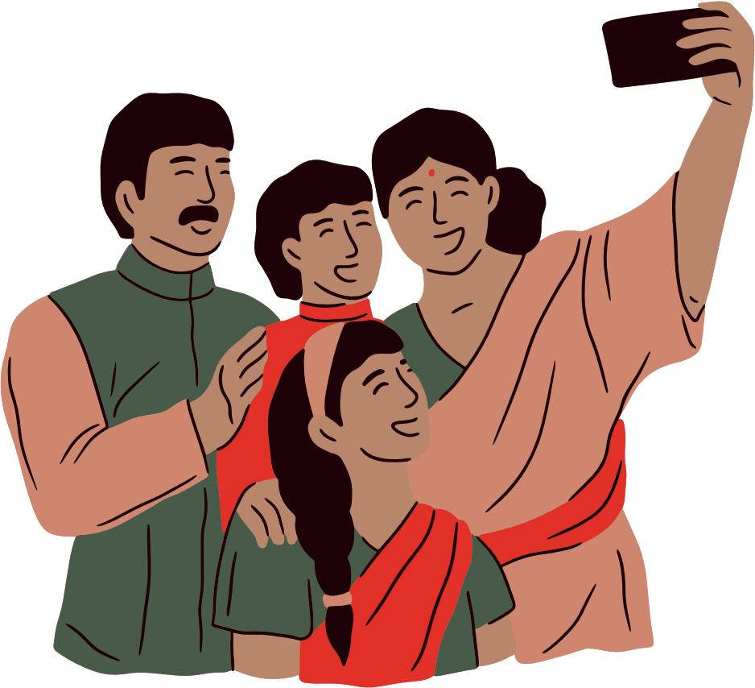

Initial ED Screening and Assessment
Community Outreach in Cultural and Religious Centers
Solutions
Public Awareness Campaign
Mughal & Arnault, 2024
Notes:
Research examining IPV in the South Asian context is limited and there is minimal exploration into avenues to tackle this problem. Therefore, we have come up with the following three solutions to hopefully lower the stigma of reporting IPV in Surrey’s South Asian community. these solutions are initial ED screening and assessment, community outreach in cultural and religious centers, and a public awareness campaign.

Slide 7

Meet Pardeep
Pardeep, mother of a two-year old girl and wife to Amanjit.
She lives with her in-laws since they moved to Surrey 3 years ago.
Her husband has been struggling at work, and his family begins to blame Pardeep for their misfortunes.
Her treatment at home has increased from emotional abuse to physical.
The only person she can speak to is her mom, who lives in India.
Notes:
Meet Pardeep. She is the mother of a two-year-old girl and is married to a man named Amanjit. She’s been living with her in-laws and husband for the past 3 years in Canada. During this time her home life has increasingly become more difficult as her husband has been struggling with steady employment and establishing the family in Canada. Her in-laws have started to blame Pardeep for the misfortunes that the family is experiencing. The treatment at home has increased from emotional abuse from the in-laws and her partner to now physical abuse as a situation deteriorates. Pardeep has only confided in one other person about her situation. She spoke with her mother, who lives back home in India, who counselled her to try her best to resolve the situation and keep her family together as to not bring shame to her family before her other sister gets married.

Slide 8

Solution 1
Initial ED Screening and Assessment
Presented by Melissa Umali

Slide 9
Description
To improve early identification of IPV, the ED triage/assessment form should include a safety at home question among the first five questions asked.
Proposed question: “Do you feel safe in your home?” this phrasing is non-judgmental and trauma informed.
It should become as routine as asking, “Do you have any allergies?”
Patients should always be assessed alone first to ensure privacy and safety before any family members enter the room.
This creates an environment of trust and reduces cultural and power barriers that silence disclosure (Lock et al., 2025; Raja et al., 2015).

Slide 10
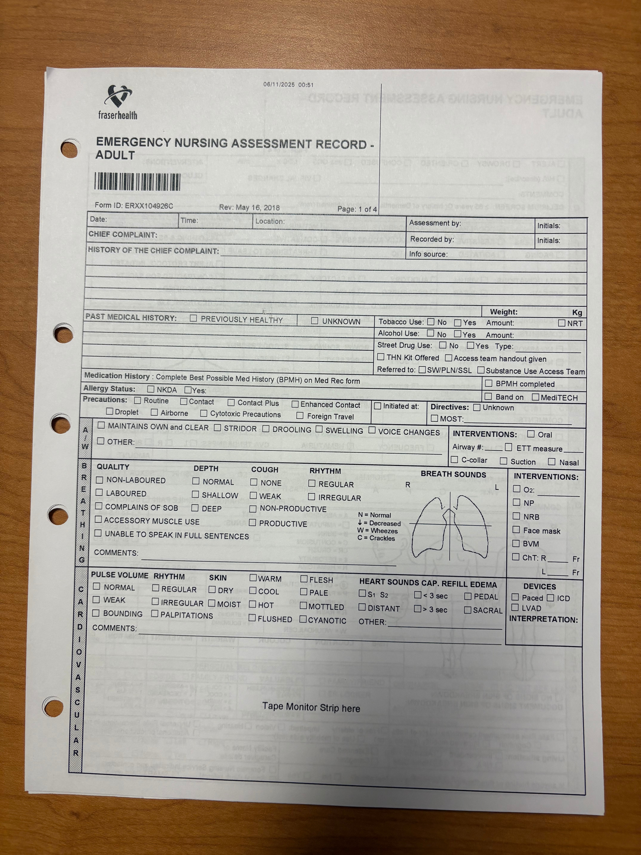
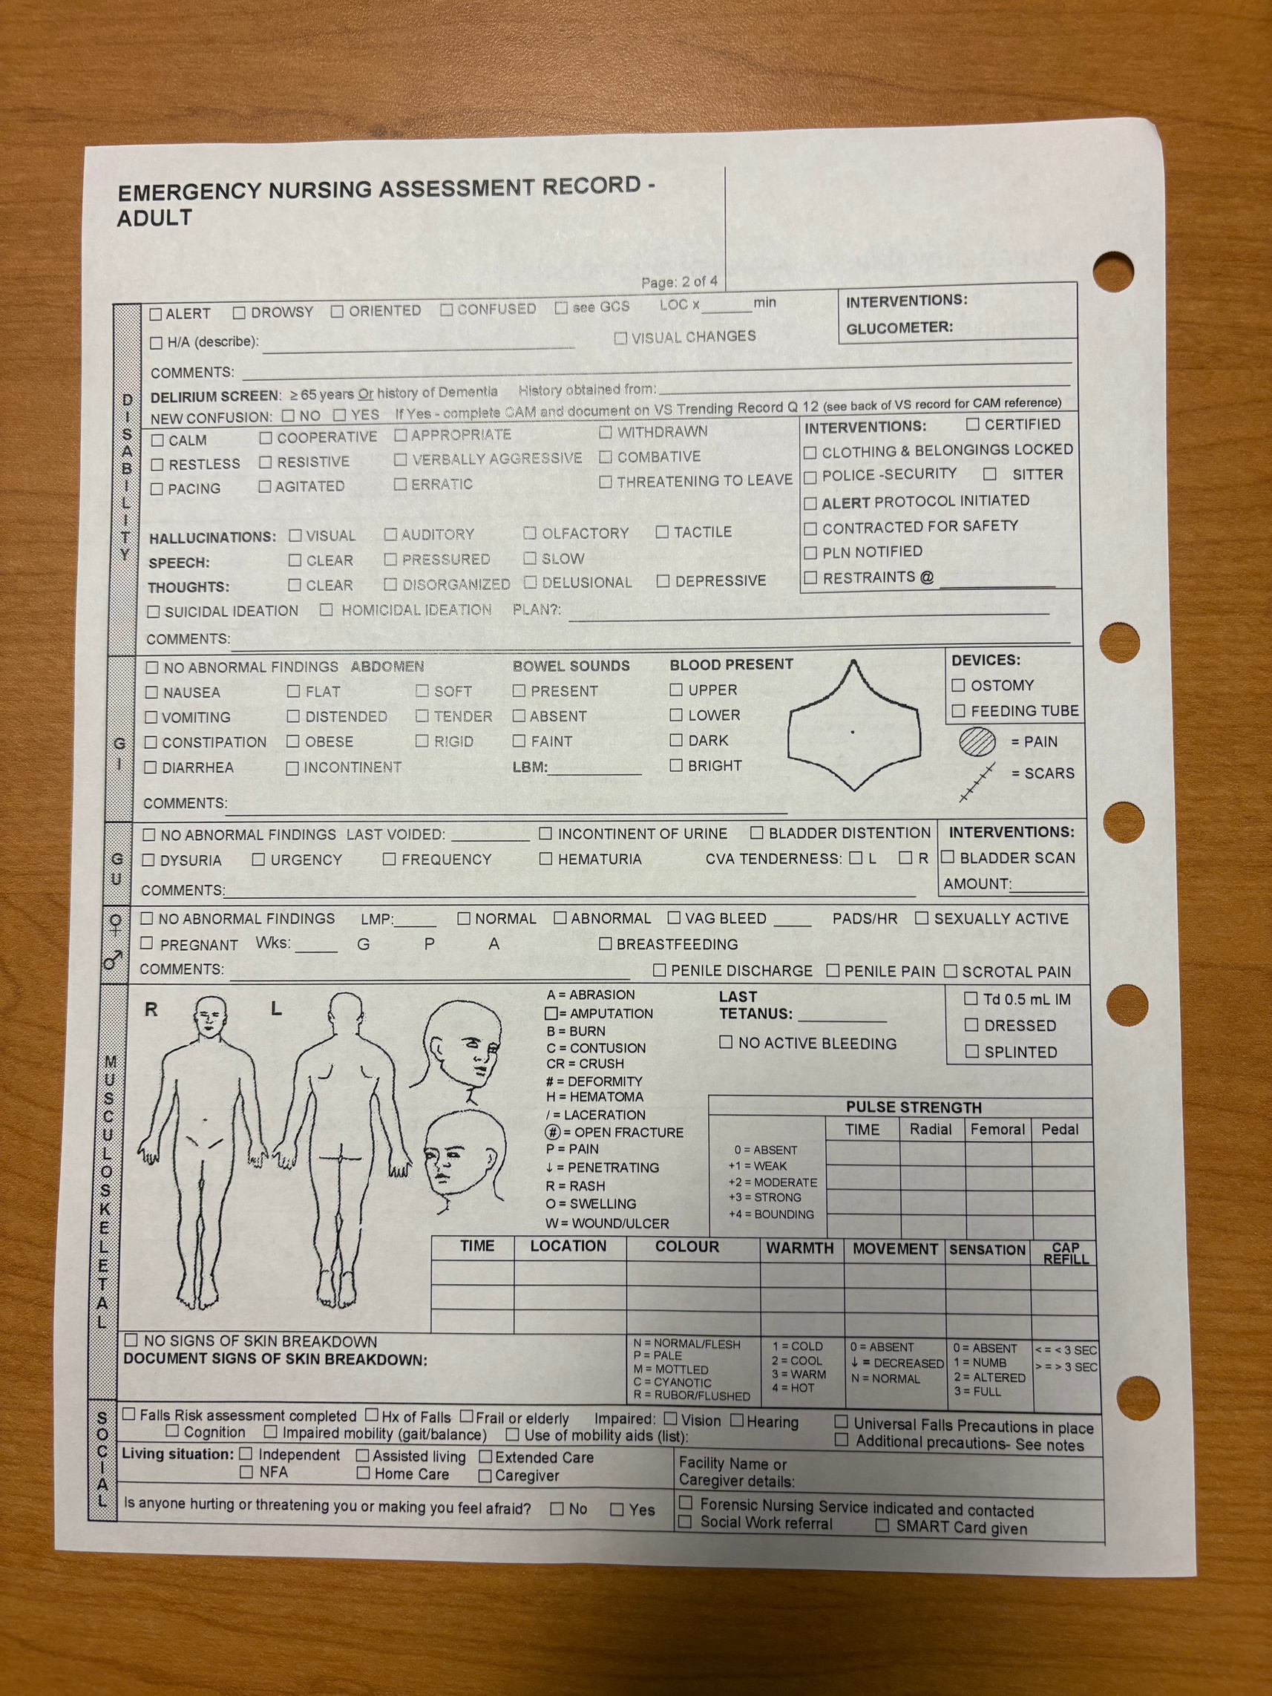

Slide 11

Strengths
• Promotes trauma informed care and builds trust with culturally diverse patients (Schreiber & Shields, 2018).
• Normalizes IPV screening as part of everyday assessment.
•Creates a safe, private and nd confidential space for women to disclose abuse (Lock et al., 2025).
• Helps identify IPV early, preventing repeated injuries and chronic trauma.
• Aligns with the BC Provincial Domestic Violence Framework and PHAC recommendations (Government of BC, 2024; PHAC, 2023).

Slide 12
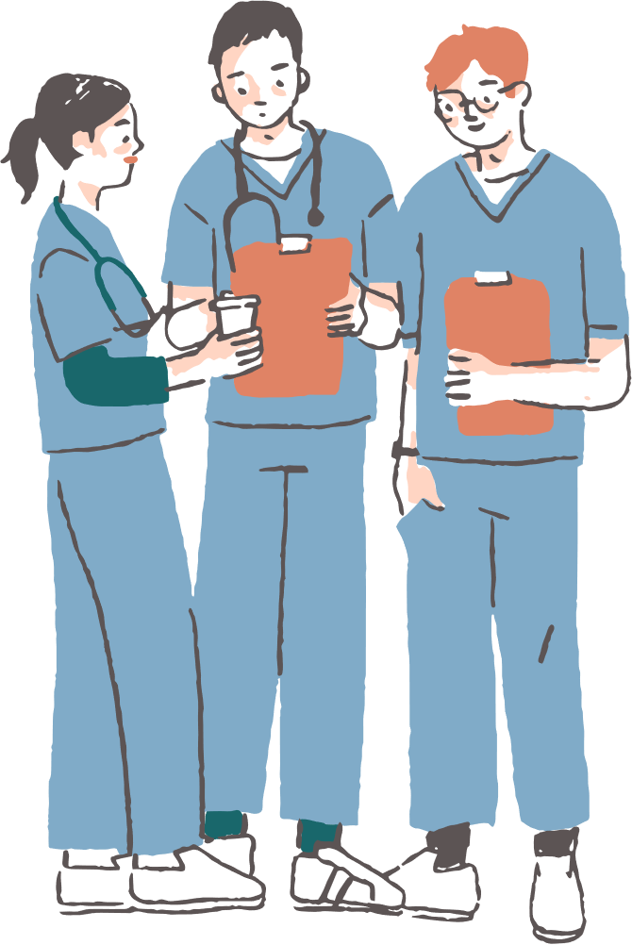
Challenges
1
Time constraints during busy ED triage.
2
Staff discomfort or lack of training in trauma informed communication.
3
Risk of re-traumatization if questions are asked insensitively (Raja et al., 2015).
4
Cultural stigma may still discourage disclosure, even in private settings (Tasbiha & Zaidi, 2023).
5
Need for consistent policies to ensure family members are not present during assessment.

Slide 13
Feasability
Feasible with proper staff education and leadership support.
Training programs can use short trauma informed modules (Lock et al., 2025).
Minimal financial cost: only minor revisions to ED forms and brief staff workshops.
Culturally safe posters or visual cues can normalize IPV screening.
Advocacy from nurse leaders can drive protocol change and sustainability (Williams & Van’t Hof, 2016).

Slide 14
Pardeep visits the ED
Pardeep visits the ED for minor injuries over the next few weeks. Her mother-in-law always comes with her.
Amanjit loses his job, the violence escalates, and Pardeep gets pushed down the stairs.
She revisits the ER with her mother-in-law... but this time it’s different
Nurse Melissa notices the suspicious nature of her injuries, and asks to do the assessment with Pardeep alone
Notes:
Pardeep has been to the ER several times for minor injuries with her mother-in-law. She has never disclosed the abuse.
Over the next few weeks, the abuse at home worsens as amanjit has lost another job. The violence escalates, and he pushes her down the stairs. Pardeep goes to the ER again with her mother-in-law however, this time her care is different. In the ER, she is taken care by a nurse named Melissa, who notices from the nature of her injuries that this may be a case of intimate partner violence. Melissa asked to do the assessment alone with Pardeep and has the mother-in-law sit in the waiting room. She asks Pardeep if she feel safe at home. Pardeep explains that she is fearful she struggles to communicate her situation as her English is limited. Melissa provides the appropriate care based on her solution and utilizes a translator. Pardeep goes home with her mother-in-law, but feels hopeful knowing that nurse Melissa was in her corner and provided her with resources to make her feel safe for the first time in a long time.

Slide 15


Conclusion
Solution 1: Initial ED Screening and Assessment
This solution focuses on implementing simple but powerful changes to how we conduct our emergency department intake and assessments.
Solution 2: Community Outreach in Cultural and Religious Centres
Providing direct community outreach and awareness at booths set up in key cultural and religious centres
Solution 3: Public Awareness Campaign
Using South Asian media outlets and restaurants/stores to enhance awareness into how IPV is a community and social problem, not a private one
Notes:
In summary, the three solutions we have come up with in tackling the wicked problem of the stigma and lack of reporting of Intimate Partner Violence in Surrey’s South Asian women are: Initial ED Screening and Assessment tools, community outreach in cultural and religious centres, and a public awareness campaign. All three solutions are strong, in that they will get the conversations we need started to start reducing the stigma and hopefully increase reporting of these incidents. Solution 1 focuses on simple and powerful changes on how the ED conducts their intake and assessments. Solution 2 would provide direct community outreach and awareness in key cultural and religious centers, and solution 3 would use south Asian media outlets and restaurants and stores to enhance awareness into how IPV is a community and social problem, not a private one. While all of these solutions would work best in tandem and have their own strengths, we believe that there is a single solution that is the most feasible at this time.

Slide 16

What can we achieve currently?
Minor changes to existing protocols
Area of change is more localized, less individuals involved to adapt to changes
Does not require change in deeply held cultural values, norms and beliefs
Measurable outcomes
Allows insight into the issue as it stands in the community
Solution 1
Notes:
Solution 1 is the intervention that we believe will be the most feasibility to implement at this time. This solution presents the least amount of challenges to implementation. Unlike Solution 2 and 3 which both require greater community and stakeholder investment. Solution 1 has a smaller focus on just the SMH ER. While this maybe less impactful in the long term it provides the opportunity to gain better initial insights into the scope of the issues. It allows for screening of community needs and shows measurable outcome earlier on. This may then be used to provide evidence for the other 2 solutions to be applied later down the road.

Slide 17
Questions and Comments

Slide 18
THANK YOU

Slide 19
References - Melissa
Atira Women’s Resource Society. (n.d.). Housing & support services. https://atira.bc.ca/
Baloch, A., Patel, S., & Khan, N. (2025). Cultural barriers to intimate partner violence disclosure among South Asian women in healthcare settings. Journal of Interpersonal Violence.
Browne, A. J., Varcoe, C., Ford-Gilboe, M., & Wathen, C. N. (2018). Equity-oriented health care: Implementation and evaluation. International Journal for Equity in Health, 17(1), 167.
Brown, R., Sampsel, K., & Stiell, I. G. (2018). Management of intimate partner violence in the emergency department. Canadian Journal of Emergency Medicine, 20(S1), S61. https://doi.org/10.1017/cem.2018.211
Fraser Health. (n.d.). Forensic Nursing Service. https://www.fraserhealth.ca/
Khatib, N., Sampsel, K., & et al. (2022). #DomesticViolence – We should routinely screen for domestic violence (IPV) in the Emergency Department (ED). Canadian Journal of Emergency Medicine.https://pmc.ncbi.nlm.nih.gov/articles/PMC9579564/
Lock, L., Ahmed, S., & Ng, T. (2025). Screening and assessment of IPV among culturally diverse women: A scoping review. BMC Women’s Health.
Mughal, S., & Arnault, D. (2024). Exploring IPV interventions in multicultural healthcare settings.Nursing Ethics, 31(5), 678–690.
Peta, D., & Mundell, A. (2023). Domestic abuse screening: Normalizing assessment at triage through simulations. Canadian Journal of Emergency Nursing, 46(1), 17–19. https://doi.org/10.29173/cjen205
Registered Nurses’ Association of Ontario (RNAO). (2024). Intimate partner violence: Best practice guideline. RNAO Press.
St-Onge, C., & Mirscore, E. (2022). Measuring trauma- (and violence-) informed care: A scoping review. International Journal of Environmental Research and Public Health, 19(23), 15672.
Surrey Women’s Centre Society. (n.d.). Programs & supports. https://surreywomenscentre.ca/
Tasbiha, A., & Zaidi, A. (2023). Understanding intimate partner violence in South Asian communities: Cultural and social barriers to disclosure. Canadian Journal of Community Health, 12(1), 55–68.
Tompa, E., et al. (2022). Trauma- and violence-informed care: Orienting IPV interventions to equity.Current Epidemiology Reports, 9, 233–244.
World Health Organization. (2021). Responding to intimate partner violence and sexual violence against women: Clinical and policy guidelines. World Health Organization.

