Slide 1





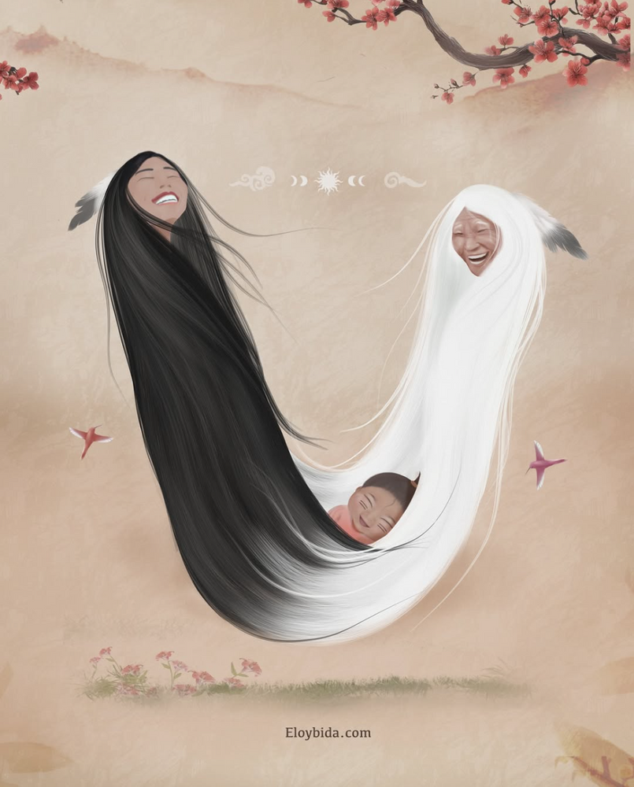

ANTI-RACISM TOOLKIT
Solstice Toews
HLTH 5200
Dr. Anila Virani
November 26, 2025
(BIDA, 2025)
FOR CULTURALLY SAFE MATERNAL CARE

Slide 2

WHAT IS CURRENTLY AVAILABLE?
INTERIOR HEALTH CULTURAL SAFETY RESOURCE HUB
IH EDUCATION MODULES
BCCNM STANDARD AND RESOURCES
FNHA REPORTS
A TON ON THE WEB
OTHER TOOLKITS:
ANTI-RACISM TOOLKIT
INDIGENOUS ALLY TOOLKIT
DECOLONIAL TOOLBOX
(INTERIOR HEALTH, 2025; FNHA, 2024; BCCNM, 2022)
(MIKANA, N.D.; HEALTH INNOVATION NETWORK, 2023; SEGAL CENTRE, N.D.)
Notes:
Read from notebook
Currently, four mandatory modules exist through IH related to cultural safety and colonization. IH: anti-racism policy, diversity policy, workplace environment policy, indigenous specific anti-racism education (still being developed – 3 phases as below).
There are three modules with accompanying toolkits regarding Indigenous-specific anti-racism education that have been created in response to the In Plain Sight report. San'yas is no longer available to IH staff as these IH specific modules are meant to incorporate these teachings. These modules are NOT mandatory and are not reimbursed. The modules incorporate a learning circle at the time of completion, and two phases of this education series is still under completion. The estimated time to complete this learning is 40 hours - again NOT mandatory, NOT paid.
BCCNM Indigenous Cultural Safety, Cultural Humility, and Anti-Racism practice standard BCCNM learning modules for practice standard, BCCNM companion guide for practice standard
FNHA answering the call specific to maternal health, MANY resources, documents and reports. 40-200+ pages each.
BCCNM has a practice standard for anti-racism. IH has a policy and education modules. However, there is no clear place the amalgamates this information for practical use.
Honestly going through all of these resources is time consuming. Having ONE bedside toolkit for practitioners that is specific to anti racist maternal care would be more efficient and practical.
We need something quick, accessible and succinct for practitioners to access as a guide to anti-racist care.

Slide 3

WHAT IS IT?
ANTI RACIST TOOLKIT FOR MATERNITY PRACTITIONERS
BACKGROUND/EDUCATION
GLOSSARY
SELF-REFLECTION
TIPS
RESOURCES
CONTACT INFORMATION
ACCESSIBLE
PURPOSEFUL
EVIDENCE-INFORMED
(BCCNM, 2022; BGC CANADA, N.D.; LAROCCA ET AL., 2012; YAMADA ET AL., 2015)
Notes:
Basically, this solution would take existing resources and combine them into one easy to usea, accessible toolkit for providers working with Indigenous life-givers. The
focus is anti-racism in maternal care.
This is a type of knowledge translation resource. Knowledge translation being the link between researchers and knowledge users, such as clinicians, to provide more effective health services and and strengthen the healthcare system (Yamada et al., 2015). This ideally supports the implementation of evidence into clinical care.
The goal of this toolkit is that the evidence and education provided leads to behavioural change and better patient outcomes as a result.
Some highlights are that this toolkit would make information accessible to providers, would have a clear purpose, and would be backed by high quality evidence.
Some background and education of forced birth evacuations in Canada and BC.
A glossary of commonly used terms, good ways to approach language, perhaps some common Secwepemc terms used in birthing, a birthing story?
WHY this matters - effects that this can have on patients, statistics, care outcomes etc.
Self-reflection
Culturally safe care tips
Resources for staff and patients - bulk of toolkit
A place for contact and feedback as follow up and evaluation is very important!
Adjunct to other solutions including education modules, in person education, and policy change.
Justice Murray Sinclair - senator 2016-2021. First Nations lawyer and judge (first in MB, second in Canada).

Slide 4
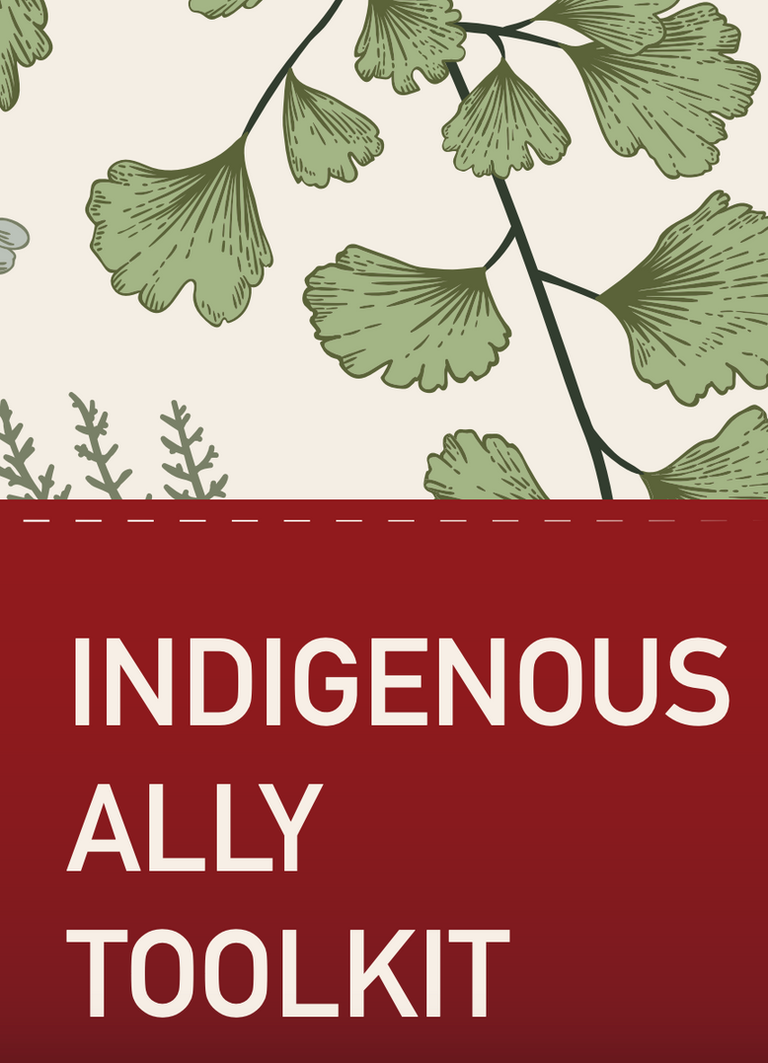
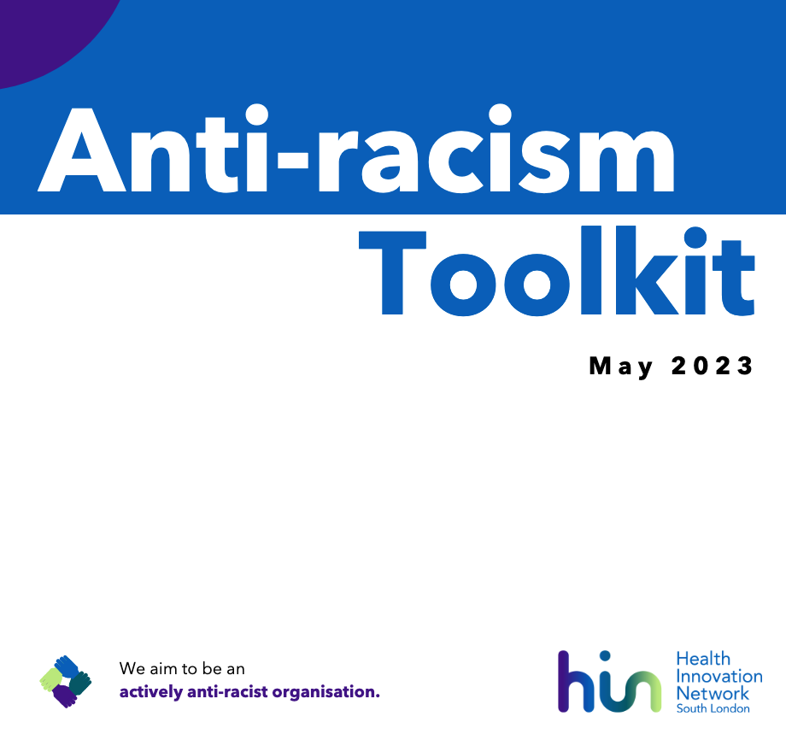
(SEGAL CENTERE, N.D.)
(HEALTH INNOVATION NETWORK, N.D.)
Notes:
Many toolkits exist in various settings, organizations like the WHO use toolkits, health authorities use them for leadership, policy, and individual guidance.

Slide 5
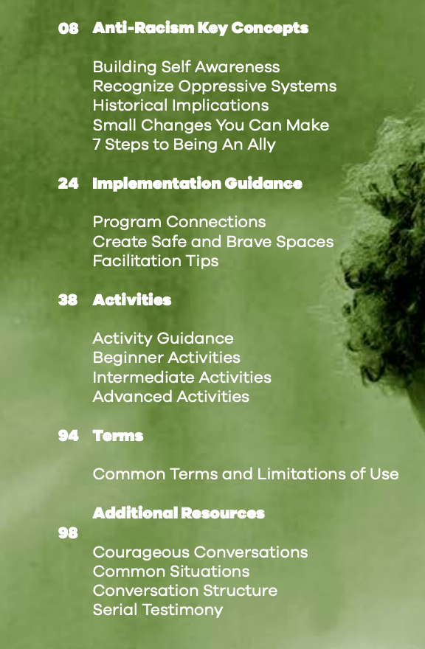
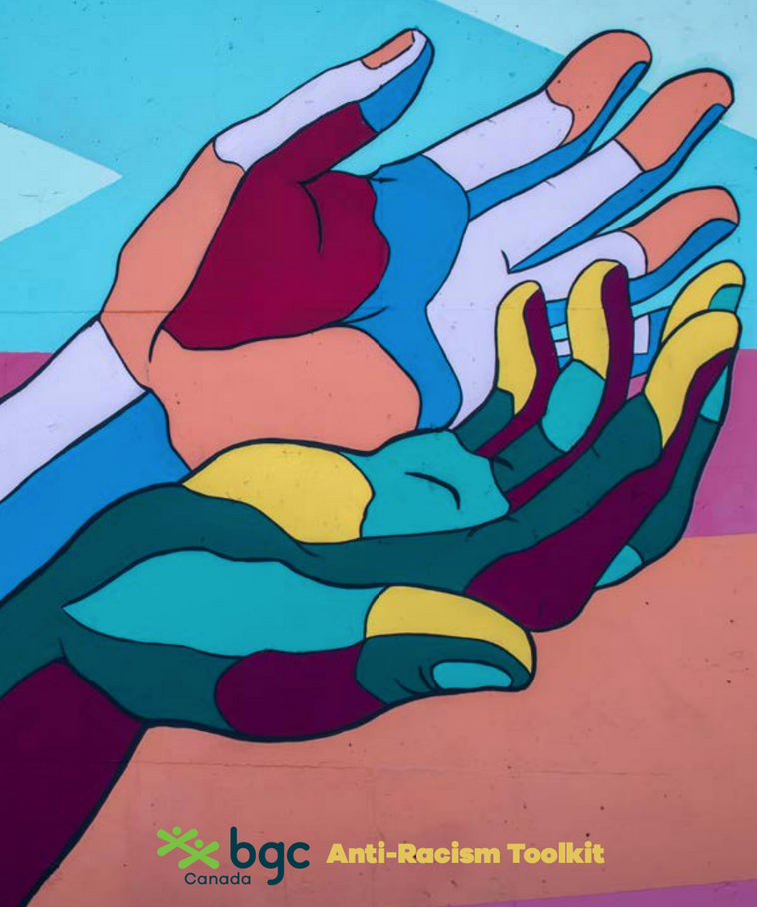
(BGC CANADA, N.D.)
Notes:
Just put the table of contents to give an idea of what toolkits can contain

Slide 6
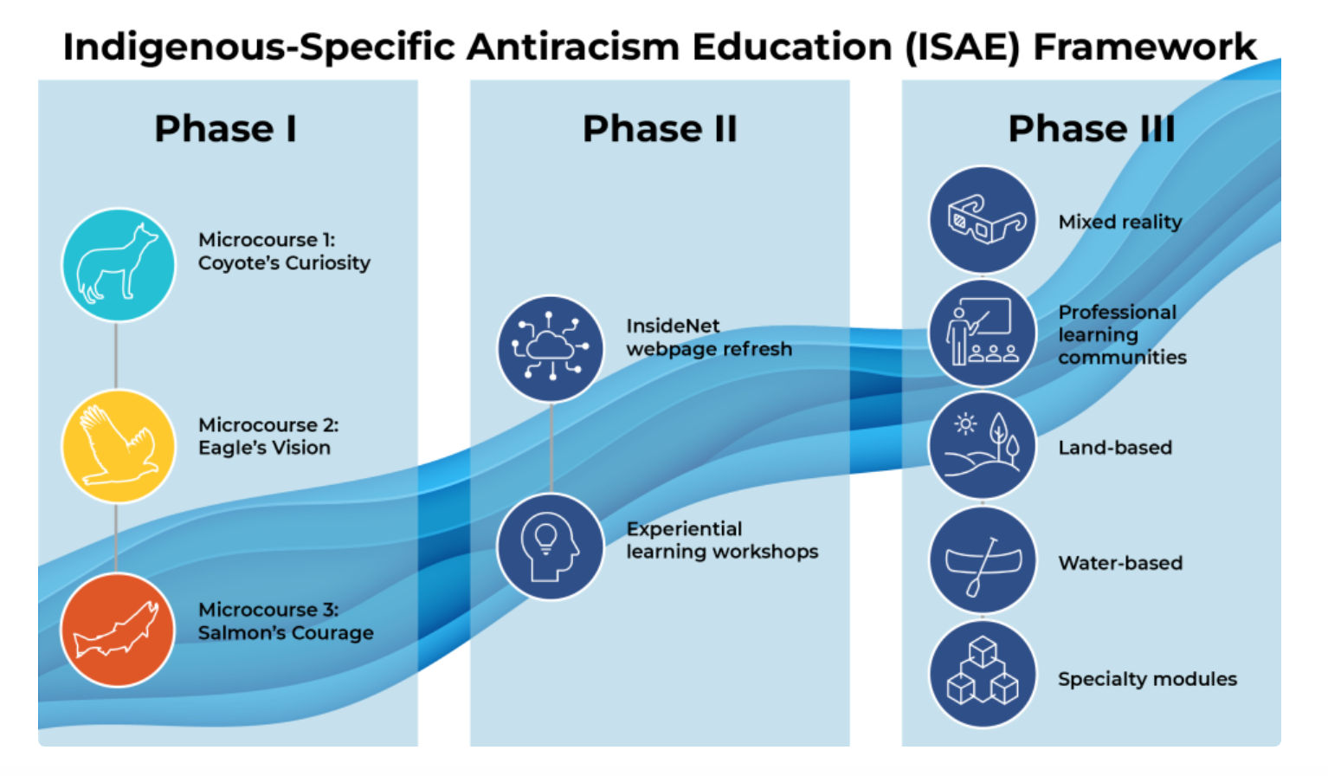
(INTERIOR HEALTH, 2025)

Slide 7
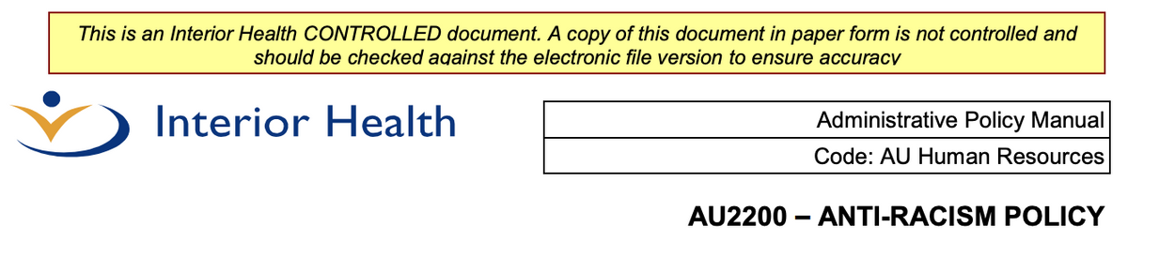
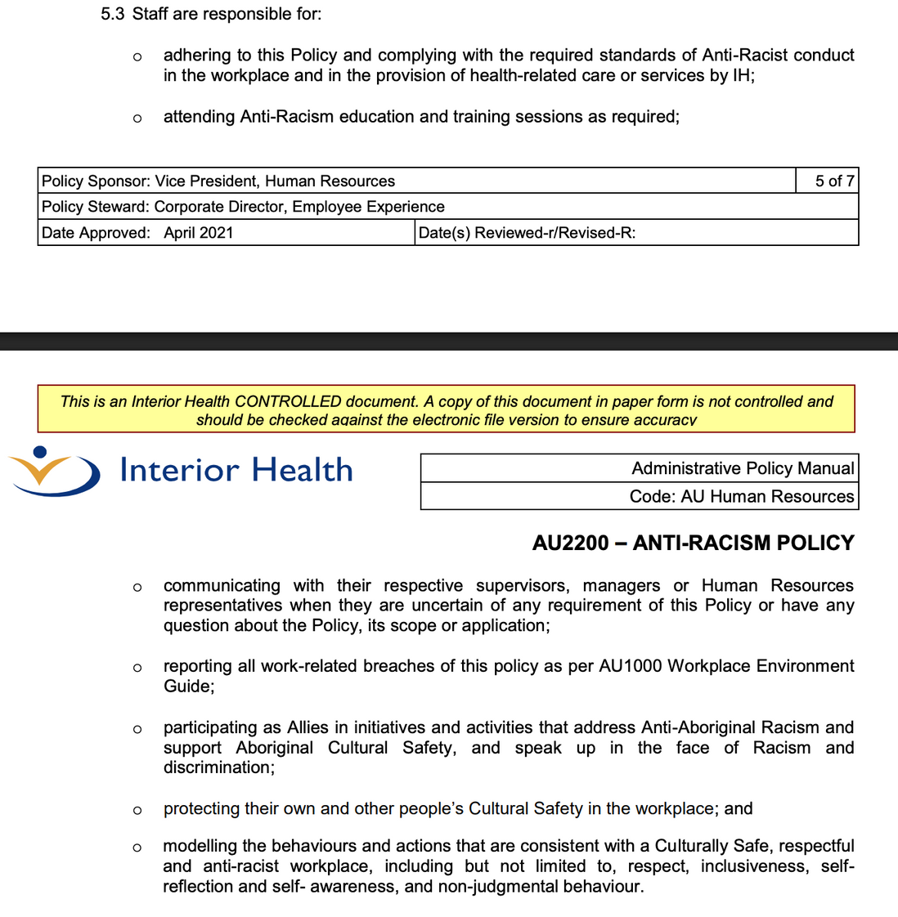
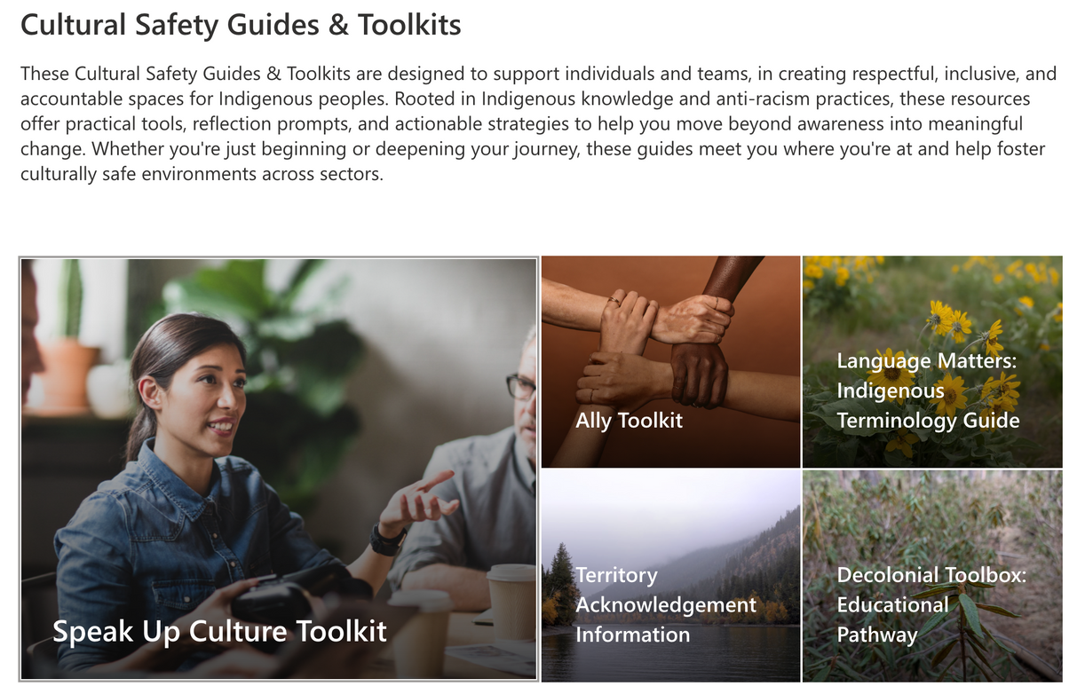
(INTERIOR HEALTH, 2025)
Notes:
LaRocca et al. (2012) suggested that the more successful KT intervention strategies were those that were accessible and could be tailored to the needs and preferences of the users.

Slide 8
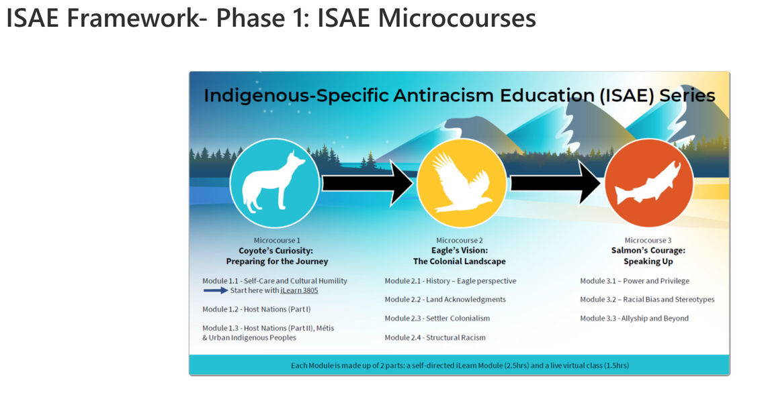
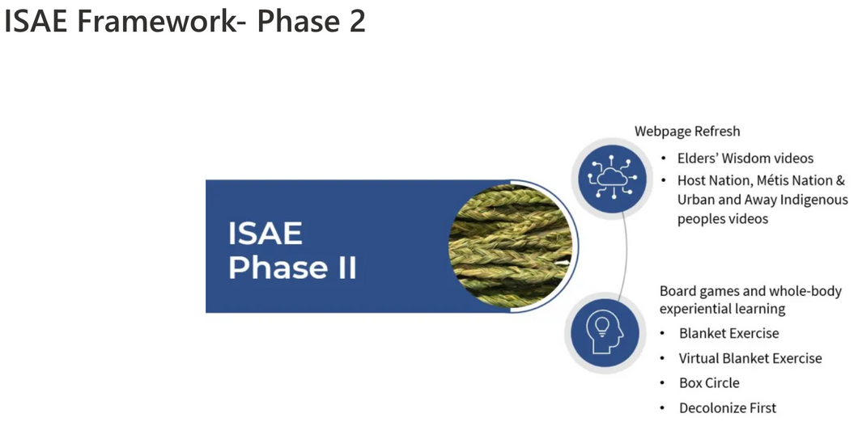
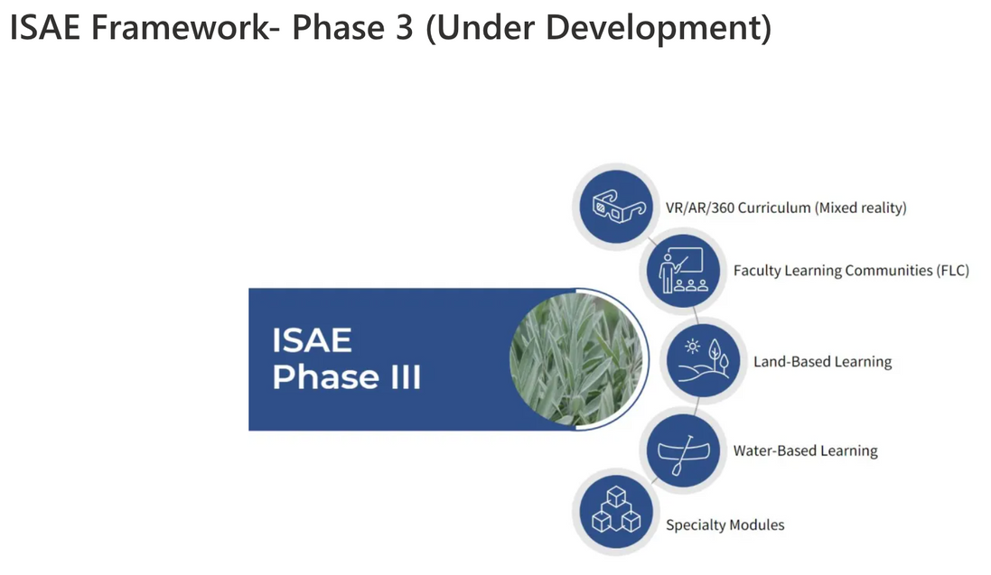
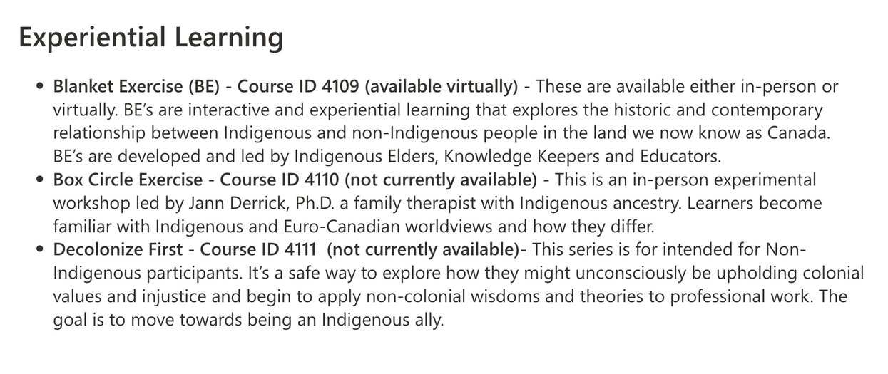
(INTERIOR HEALTH, 2025)
Notes:
Note -
Phase 1 modules are all available online to staff, they are NOT mandatory or paid
Each module has a toolkit to go along with it
Phase 2 webpage refresh has been done
Experiential learning has ONE course available virtually only
Phase 3 as you can see is "under development"

Slide 9
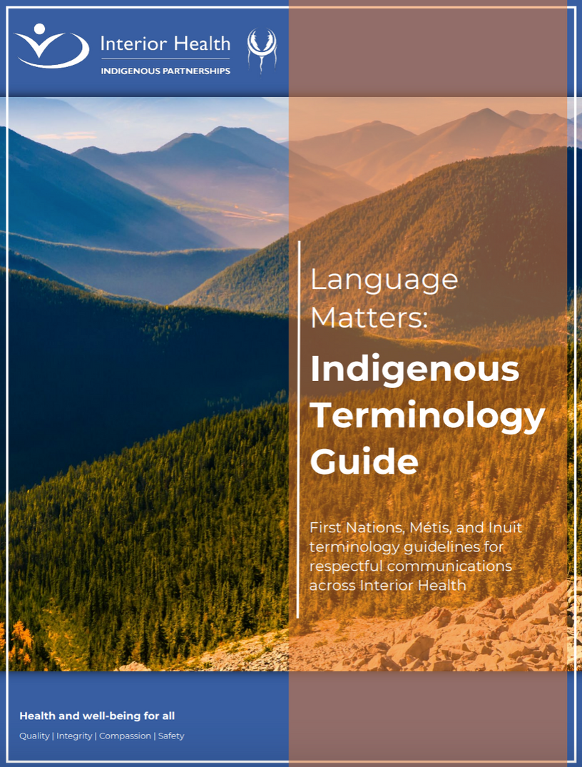
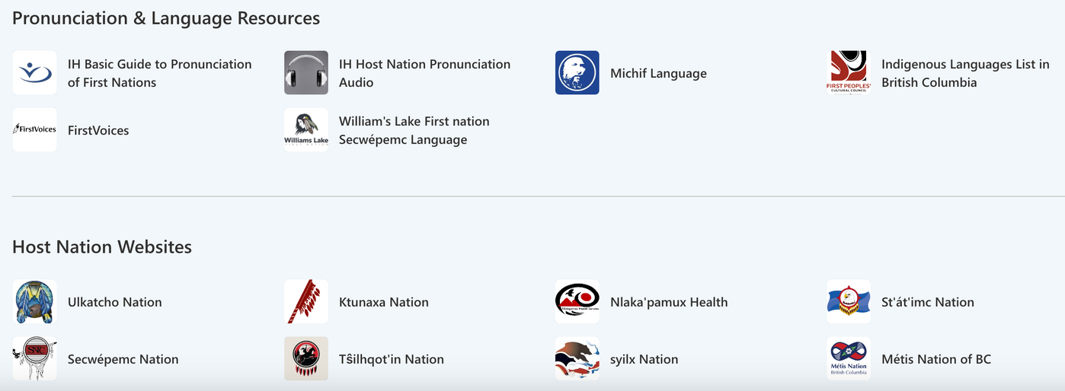
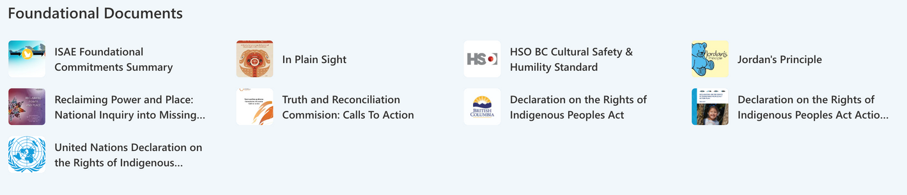
(INTERIOR HEALTH, 2025)
Notes:
Part of the web page refresh
It is actually MUCH more use friendly in my opinion and has a lot more information, quick links, some toolkits, and is more visually appealing. This happened this month as far as I am aware.
IH has 31202 staff (IH quick facts, Jun 2, 2025). 448 UNIQUE viewers to cultural safety hub as of Nov 12, 2025. 1.4% of staff have accessed this page.
Clearly, we need a way to make information more obvious and accessible to employees. There is so much good information out there and good work that has already been done, but we need employees to actually access it.

Slide 10

IMPLEMENTATION & CONTEXT
RIH MATERNITY WARD, PAR, SETTINGS CARING FOR BIRTHING INDIVIDUALS
QR CODE
WEBSITE
POSTERS
POCKET CARDS
FIRST NATION INPUT
USE EXISTING RESOURCES
FOLLOW UP
EVALUATION
(YAMADA ET AL., 2015)
Notes:
Implementation plan:
(tailor to local context)
This toolkit would be rolled out at the hospital in Kamloops, RIH, on the maternity ward and possibly other wards that care for maternity patients such as the recovery room. Hopefully the time to put together a short toolkit and roll it out would be a few months.
Ideally, the roll out would include more than just a printed toolkit. For example, posters, pocket cards, bedside card deck, stickers with QR codes that practitioners can scan to access the toolkit online and therefore access linked documents more easily. These would also serve as physical reminders, which is a knowledge translation strategy (Yamada et al., 2015).
It is hard to cut down and include only necessary information to make the toolkit accessible for busy providers.
IDEALLY we would get First Nations input - perhaps from patients, Indigenous patient liaisons, or an elder if possible on what is most important to include in the toolkit. Community/primary care RN's may also be able to provide insight based on what they have seen. The bulk, if not all, of the information would be already accessible to IH employees to make the rollout as feasible as possible. There has already been SO much work done by Indigenous peoples related to this issue, so the idea would be to amalgamate this work rather than start from scratch.
For example, maternity ward uses poster with evidence showing why skin to skin is effective.

Slide 11

(Goade, 2024)
Notes:
How would this toolkit help our patient?
To tie this in with our example, take Leah, our young mother.
She arrives to the hospital from her community, away from family and supports. Because staff are familiar with the toolkit, they realize the struggles that Leah may be going through to give birth WITHOUT her having to explain to them. They are familiar with some of her cultural language and practices. Staff are more aware of their own biases.
They are able to more safely provide care and form a trusting relationship with Leah.
They are able to access resources if unsure and ask Leah what she needs with more confidence that they will be able to provide this cultural support.
Over time, the ward culture normalizes accountability and self-reflection.
When individual practitioners are able to shift their views and practice, then the ward slowly shifts, this can spark changes to entire systems, person by person, ward by ward, hospital by hospital.

Slide 12
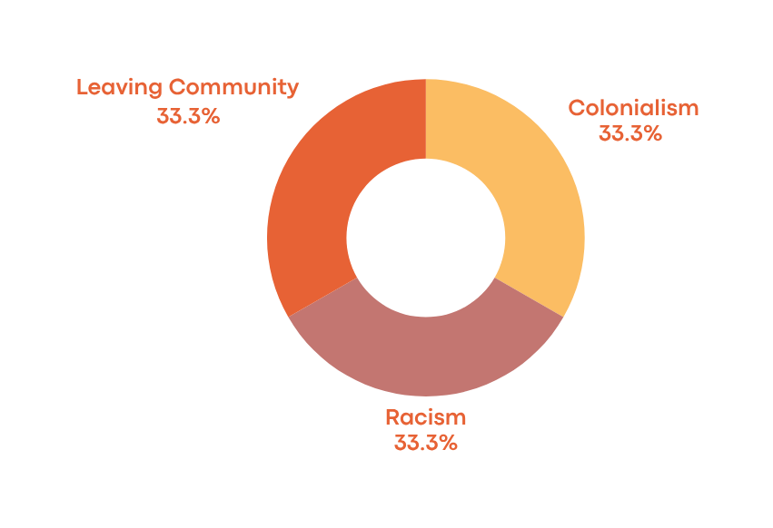
RATIONALE
Risk to First Nation’s Lifegivers
RACISM REMAINS PREVALENT IN HEALTH CARE
THIS IS A BARRIER TO SAFE CARE
TOOLKITS HAVE BEEN SHOWN TO BE HELPFUL IN RELAYING EVIDENCE IN AN ACCESSIBLE WAY
HOWEVER, THEY MUST BE IMPLEMENTED PROPERLY TO BE EFFECTIVE
(C4DISC, 2021; DURANT ET AL., 2024; HASSEN ET AL., 2021; LAROCCA ET AL., 2012; MIKANA, N.D.; TURPEL-LAFOND, 2020; YAMADA ET AL., 2015)
Notes:
Indigenous Peoples’ rates of perinatal mortality and stillbirth are 2–2.5 times higher than the Canadian average (Durant et al., 2024).
One of 3 biggest wholistic risks to indigenous life givers remains racism (Durant et al., 2024). This assesses risks from more than just a biomedical lense and is imperative to consider.
We need solutions to make care safe for Indigenous peoples.
As per Yamada et al. (2015) toolkits hold PROMISE as an effective approach to evidence use in practice and improving outcomes.
LaRocca et al. (2012) suggested that the more successful KT intervention strategies were those that were accessible and could be tailored to the needs and preferences of the users.
This toolkit would contribute to this overarching goal by providing easy access to education and resources.
A toolkit allows the user to select strategies in the toolkit that are supported by evidence of effectiveness and use them at their own discretion, according to their aims, resources and context (Yamada et al., 2015).
STRENGTHS:
-flexibility of use
-uses existing resources
-providers choose what will help them in that moment and how to apply the information
-a bedside toolkit could help to address the interpersonal aspect of change
-can help providers and patients work together and build stronger, trusting relationships
-takes burden off of patients and families to explain background to providers
-addresses racism
One step towards a bigger goal:
Anti-racism interventions are needed at systemic, organizational, interpersonal (patient⁄ provider) and patient- or family-centered levels simultaneously over an extended period of time to create impactful and sustainable change in healthcare settings (Hassen et al., 2021).

Slide 13
IMPLEMENTATION & CHALLENGES
TIME, MONEY, STAFFING
COMMITTING LEADERSHIP
RESISTANCE TO CHANGE
INCREASED WORKLOAD
SYSTEM STRUCTURE/SUPPORT
AUTONOMY
TEAMWORK
BUY IN
UPDATED LINKS
ACTIVE DISSEMINATION
EDUCATION
LEADERS
LOCAL CHAMPIONS
PROPER ROLLOUT
RESOURCES LINKED TO TOOLKIT
EDUCATORS
CULTURAL SAFETY AND HUMILITY TEAM
UNIQUENESS OF CULTURES AND NATIONS
FIRST NATION INPUT
(YAMADA ET AL., 2015; LAROCCA ET AL., 2012)
Notes:
More detail re implementation plan:
Knowledge translation resources often overlook implementation outcomes.
A toolkit seems like a very simple concept, or it did to me, but there are actually quite a few things to think about when developing a toolkit or any type of educational material.
Like I touched on before, it is important that each component within the toolkit have a purpose and rationale that is clearly described for users (Yamada et al., 2015). Components should be developed and informed with high quality evidence, ESPECIALLY because the goal is to change practice.
Delivery methods should be guided by a comprehensive implementation process, ie how are we going to implement this properly?
?And, an evaluation plan and study design that links and helps explain the factors that led to effectiveness and successful implementation.
Toolkits alone (passive dissemination) are almost always not successful. Need active dissemination, education, leaders, local champions etc.
Challenges include:
Time
Money
Inadequate staffing
Lack of teamwork
Belief against guideline or staff buy-in
Conflict with clinical autonomy
Emotional response and confidence in skills
Resistance to change
Change fatigue
Associated increased workload
Lack of noticeable improvement from guideline
Keeping links up to date!
Lack of organizational support
Including committing leadership to taking action
Healthcare system structure
Saved these for last because they are bigger challenges as SYSTEMIC CHANGE IS NEEDED!!
Particular to this toolkit,
uniqueness of cultures and nations served and First Nations input need to be considered.
Example: Evidence Based Practice for Improving Quality (EPIQ) is an example of a KT intervention that combines evidence, continuous quality improvement, an implementation process and assessment of implementation outcomes.
In phase 1 (Preparation), the hospital unit identifies an implementation team, who are trained to review existing unit pain practices, guidelines and research evidence to inform targeted practice changes.
In phase 2 (Implementation), the team identifies specific pain practice aims and KT strategies (eg, educational outreach, reminders and audit and feedback) to implement using quality improvement cycles.
EPIQ was effective in improving pain process outcomes (ie, pain assessment and management) and reducing the odds of having severe pain by 51%.

Slide 14
FEASIBILITY
CHAMPIONS
INVOLVING PATIENTS AND PRACTITIONERS
ACTIVE ENGAGEMENT
MAINTAIN STAFF AUTONOMY
BUILDING VALUE
WELL DESIGNED
NOTICEABLE OUTCOMES
ENVIRONMENTAL MODIFICATIONS
EVALUATION
ADEQUATE RESOURCES AND TIME
USING EXISTING RESOURCES AS MUCH AS POSSIBLE
CULTURAL SAFETY AND HUMILITY TEAM
TIMELY
(MCARTHUR ET AL., 2021; YAMADA ET AL., 2015))
(C4DISC, 2021; INDIGENOUS CULTURAL SAFETY AND HUMILITY TEAM, PERSONAL COMMUNICATION, SEPTMEMBER 22,2025; INTERIOR HEALTH, 2025; TRC, 2015)
Notes:
feasibility and recommendations for overcoming challenges
Adequate resources and time in themselves are facilitators to implementation of resources. There are so many toolkits out there that could be used as a guide to creating this specific toolkit. While it is tempting to include as much information as possible, I think that using existing resources and keeping information as succinct as possible will make this project more feasible. It can always be built upon. This will also allow a faster rollout and minimal resource use. Using the cultural safety and humility team at IH as a resource for time and money to put into this toolkit is a possibility (personal communication). they could also keep links up to date?
Basically, what I learned through looking into successful implementation of tools like this is that they cannot just be rolled out or placed on a unit on their own with nothing surrounding the resource. You need
Champions to support implementation --> this could be nurse educators could play a role, nurses from the floor. You need in-services or education surrounding the resource and its purpose. This should include continuing education around the toolkit, it's goals and achievements.
Just saying... as quoted from IH's anti racism policy it is manager's RESPONSIBILITY to Organize Anti-Racism education, training and professional development opportunities for staff
This is timely!!! We NEED anti-racism resources to stay relevant. Looking at the TRC calls to action, in plain sight report, FNHA answering the call, national inquiry into missing and murdered indigenous women and girls, interior health anti-racism policy, among so many others - this needs to be a priority NOW. Should be a part of performance evaluation.
Other successful implementation strategies:
Patients and families should be involved. Efforts are required to ensure that knowledge users actively engage with toolkit materials, moving away from passive diffusion (Yamada et al, 2015). This is all linked to staff buy-in and actual use of the toolkit.
This type of resource could be more successful than others as it has been suggested strategies that are accessible and can be tailored to the needs and preferences of the users have better buy in. (LaRocca et al., 2012). This maintains autonomy.
Staff value the intervention
Well designed resources - make it visually appealing and easy to use!
Attitude that intervention is evidence based and will lead to positive outcomes/improvements. Noticeable outcomes from a solution make staff more willing to use it.
Innovative environmental modifications that promote resource usage
A few other facilitators to implementing knowledge translation resources include
Coordination among staff
Good communication and information flow
Shifting from education etc to
anti racism means changing policy and the way that organizations work at a high level.

Slide 15
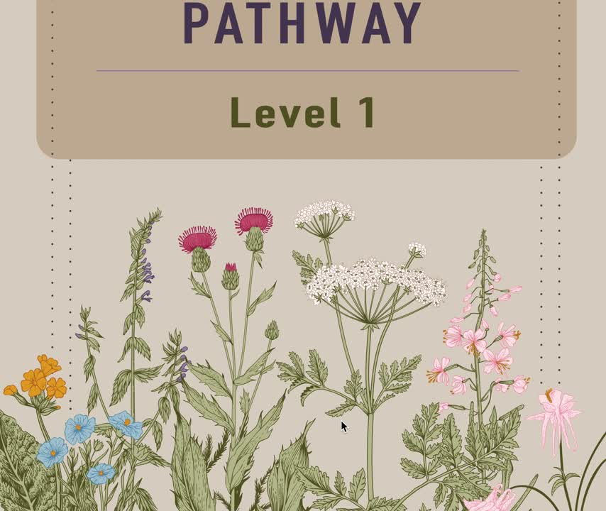
(MIKANA, N.D.)
Notes:
A decolonial toolbox designed by the Mikana network in Quebec with partners.

