Slide 1


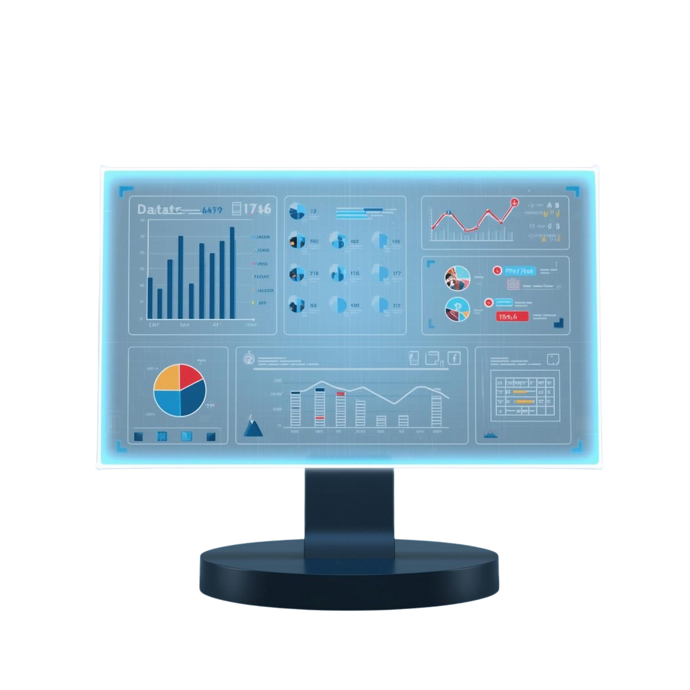



INTERNATIONALLY EDUCATED NURSES AT VICTORIA GENERAL HOSPITAL - CHALLENGES TO INTEGRATION AND THE AIM OF ENHANCING RETENTION
DIGITAL EVALUATION
Ancy cletus Leena

Slide 2
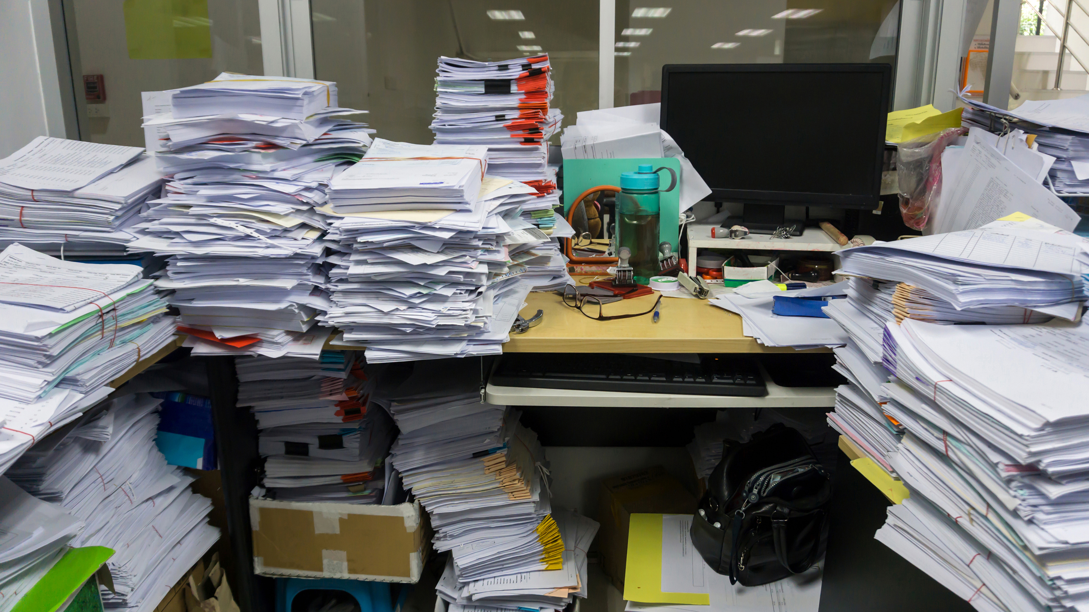




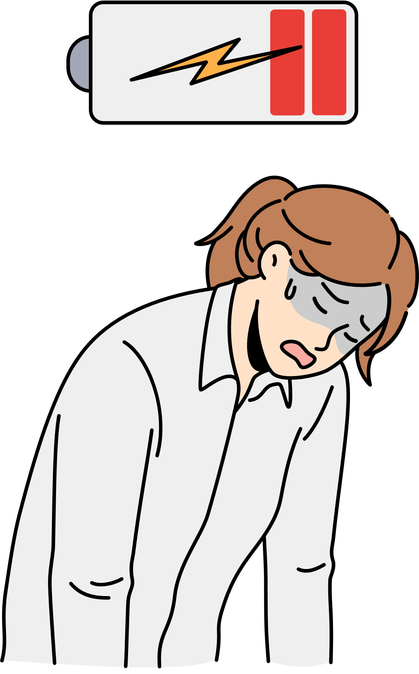

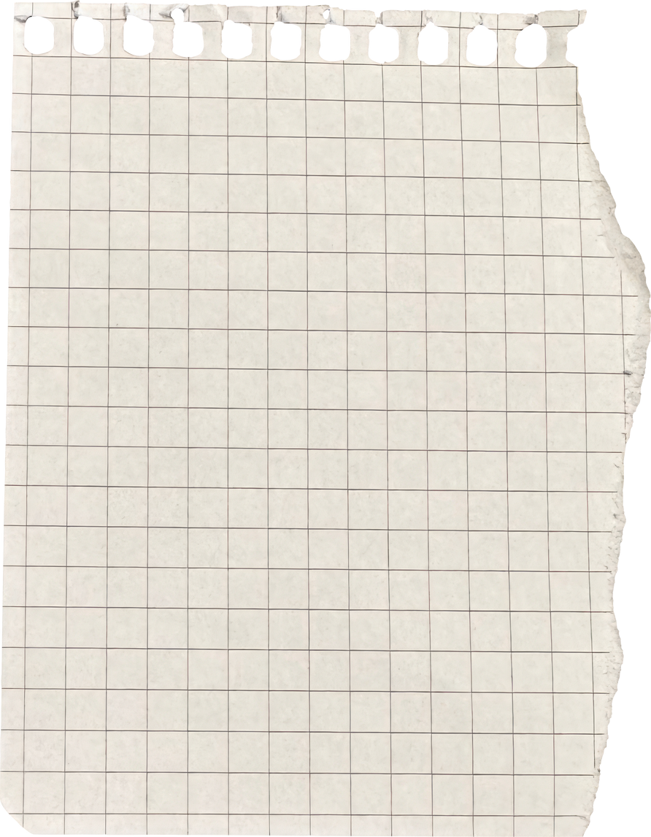



WHAT IS AVAILABLE AND WHY IT IS NOT WORKING
VGH
31 page daily and weekly learning plan
IEN
2 page weekly feedback
Large acute-care hospital with 344 beds
serving about 400,000 people
ER wait times 7-8hours
missed or inaccurate feedback
Delaying Individualized Support
According to Joel Asignacion, Clinical Nurse Educator at Victoria General Hospital, “since July 2025, 10 IENs have started orientation in our unit alone” (J. Asignacion, personal communication, October 2025).
CNE
review dozens of handwritten pages

Slide 3

EVIDENCE
What the Research Examined
What the Finding Showed
1) Abbasi & Alvi (2019): Reviewed organizational appraisal systems to assess fairness, timeliness, and developmental impact of traditional paper-based tools.
Reported that paper appraisal systems showed bias, delayed feedback, and poor linkage to daily practice, limiting developmental value.
2)Mokhber et al. (2024): Conducted a systematic review titled “The Good, the Bad, and the Ineffective: An Appraisal of Performance Appraisals,” analyzing effectiveness of annual, paper-based review processes across industries.
Concluded that traditional evaluations are viewed as ineffective because they lack fairness, transparency, and continuous feedback.
3) Harter et al. (n.d.): Examined performance-review cycles in firms of ≈ 10 000 employees to determine whether paper/manual reviews improved engagement or performance.
Found that manual, paper-driven reviews consumed significant time and administrative cost but produced negligible improvements in engagement or outcomes.

Slide 4



SOLUTION
DIGITAL EVALUATION TOOL
what it is ?
An online, end-of-shift micro-evaluation that replaces paper forms; auto-summaries to CNEs; live dashboard
Originality
Modification of existing orientation tools using digital capture + feedback loops (not brand new, but system-reshaping).
CERNER
Paper tools are slow in acute care; digitized/app forms cut documentation time and speed up feedback (Volkan, 2024; Hemesath et al., 2023).
VGH
Why now?

Slide 5
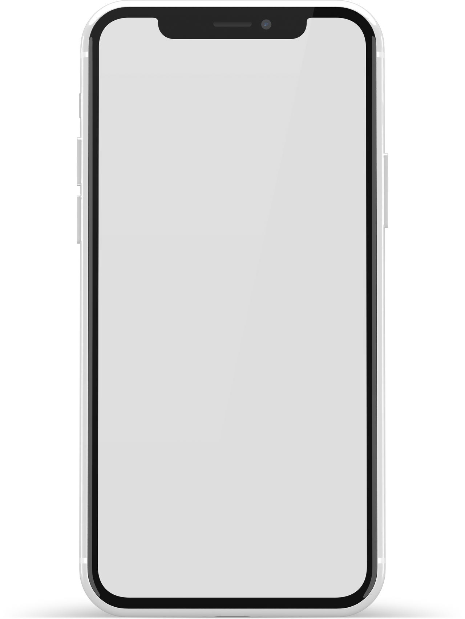






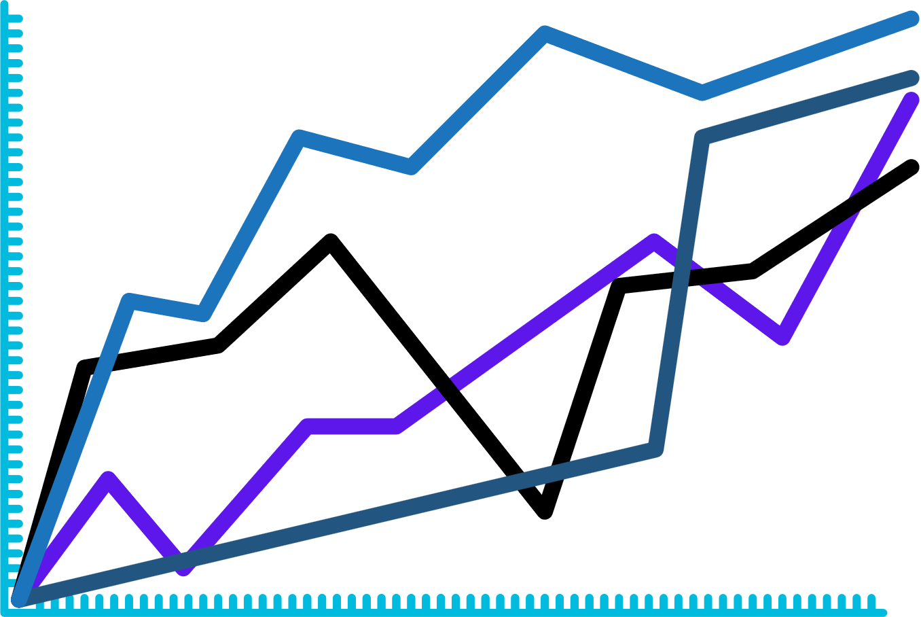
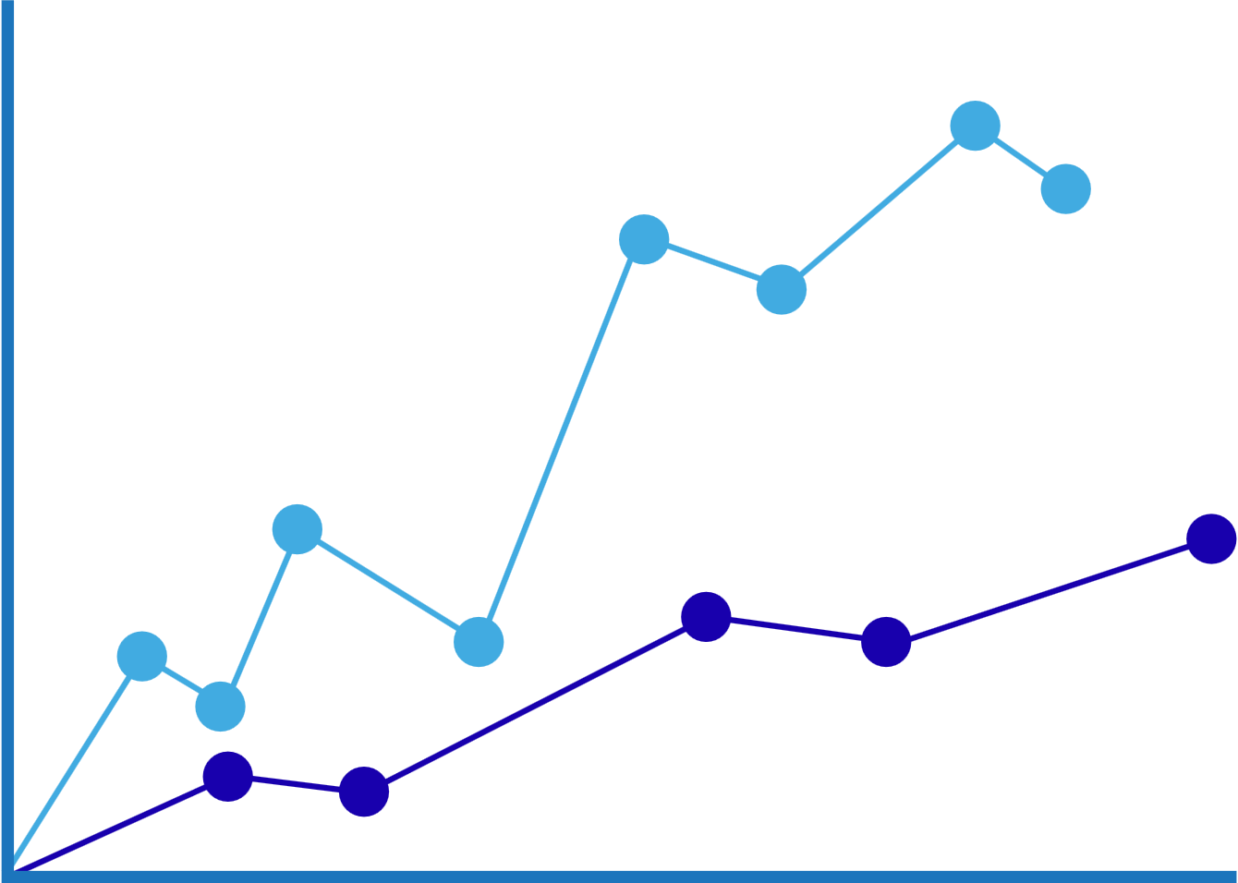

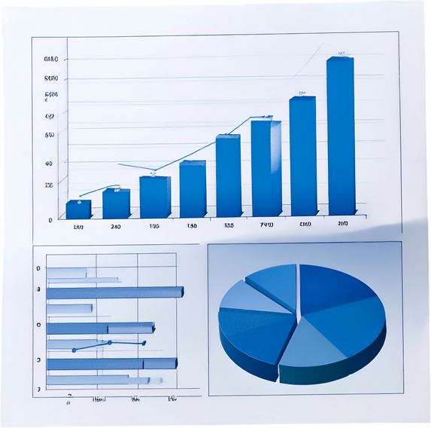







Description of the solution
Self Evaluation VGH
Weekly Report: IEN
My Progress Dashboard
INTRANET
1) Did you feel confident completing your assigned skills today?
✅ Yes ❌ No
Name of the employee:
Employee ID:
Date:
Orientation/Skill day
Communication dashboard
Progressive badge
1) confidence & Competency growth
50%
2) Which skill challenged you most?
Progress Overview
Communication= 25%
Documentation= 30%
Skills= 25%
Leadership= 30%
Decision making= 15%
3) How confident are you to work independently on the floor?
New Employees
2) Skills needing reinforcement
Acheivements/ next Steps
50%
Communication= 25%
Documentation= 30%
Skills= 25%
Leadership= 30%
Decision making= 15%
✅Completed medication safety module
✅ Passed communication scenario
🔜 Next: Documentation workshop (Thursday)
4) Any comments of reflection
Felt unsure about
new IV pump
Contact/Email
My Progress
Assign Learning Plan
Schedule
Learning Resources
Self evaluation
Submit
Contact/Email
Mentor
IEN dashboard
Educator dashboard
IEN dashboard
(Mock-up concept created for academic presentation: Leena, 2025)

Slide 6






Rationale and Strength of Solution
Real-time feedback → closing delay gap from shift to review.
Time-efficient data capture → digital tool freed up valuable shift time (Shajani et al., 2024)
Enhanced engagement & reflection → students felt more connected to their progress (Johnsen, 2024)
Better alignment with daily practice → tool mentioned to mirror actual workflows rather than retrospective forms
Data-driven insights → captured metrics enabled educators to tailor support more responsively

Slide 7


EVIDENCE OF SUCCESS
Studied a digital clinical tracking app versus paper evaluations in nursing education.
Found higher usability, timeliness, and data accuracy with the digital tool.
Reported reduced documentation time and more meaningful real-time feedback.
Shajani et al. (2024)
Explored a mobile guidance and assessment tool for first-year nursing students.
Digital users showed greater engagement and confidence through instant feedback.
Paper-only evaluations were viewed as slow and less relevant to daily learning.
Johnsen (2024)
Ryan C. (2024)
Reviewed studies on mobile applications in nursing education and practice.
Found consistent improvements in motivation, reflection, and skill mastery.
Concluded digital tools create a personalized, adaptive feedback system.

Slide 8
implementation
Phase 1
Launch the digital evaluation form on the Neuroscience Unit at VGH for all IENs in orientation.
(Platform: Microsoft Forms / PowerApps integrated through Island Health intranet)
Pilot: Weeks 1-8
Phase 2
Training
Conduct a 45-minute micro-session for preceptors and IENs; provide a one-page quick-start guide on phones or WOWs (Workstations on Wheels).
Phase 3
CNE reviews dashboard twice a week, addresses top barriers, and adjusts form items if needed.
Monitoring &Feedback
Phase 4
Evaluation & Scale up
After 8 weeks, analyze confidence scores, completion rates, and retention; present results to the Nursing Education Council for expansion across acute units.

Slide 9




Challenges
🕒 Time & Staffing: High patient load may limit time for end-of-shift reflections or educator review.
💻 Technical Barriers: Some staff unfamiliar with digital forms; potential network or device access issues.
💰 Financial Considerations: Minor budget required for IT setup, training materials, and device updates.
🔒 Privacy / Compliance: Must meet PHIPA and Island Health data-protection standards.
Challenges are not barriers-they are opportunities for smarter design

Slide 10







FEASIBILITY
RECOMMENDATION
1️⃣ Pilot Implementation (8 Weeks)
The tool can be created using Microsoft Forms or PowerApps already available in the Island Health MS365 suite, no new software cost.
High feasibility within
existing infrastructure
Launch within the Neuroscience Unit; track completion rates, feedback timeliness, and user satisfaction.
2️⃣ Staff Engagement & Support
Requires minimal setup time and internal IT support; pilot cost limited to training and form design hours.
Low Financial Demand
Appoint a “super-user” nurse for digital help; schedule brief refresher sessions for preceptors.
3️⃣ Protected Reflection Time
Once tested in the Neuroscience Unit, the same template can be adapted for other departments.
Scalable across units
Dedicate 10 minutes at end of shift for IEN reflection and preceptor review.
4️⃣ Privacy & Compliance
Collaborate with the Island Health Privacy Office to ensure PHIPA/FOIPPA standards are met.
Supports Island Health’s digital transformation strategy and promotes evidence-based evaluation practices.
Alignment with system goals:
5️⃣ Scale-Up Plan
After successful pilot, present outcomes to Nursing Education Council for system-wide adoption.

Slide 11



Thank You!
IEN

