Slide 1
Food Insecurity for Northern Indigenous Communities in Whitehorse, Yukon
Brenna Bull, Chelsey Jeffrey and Joscelyne Bergen
HLTH 5200: The Canadian Health Care System
Dr. Anila Virani
November 5, 2025

Slide 2
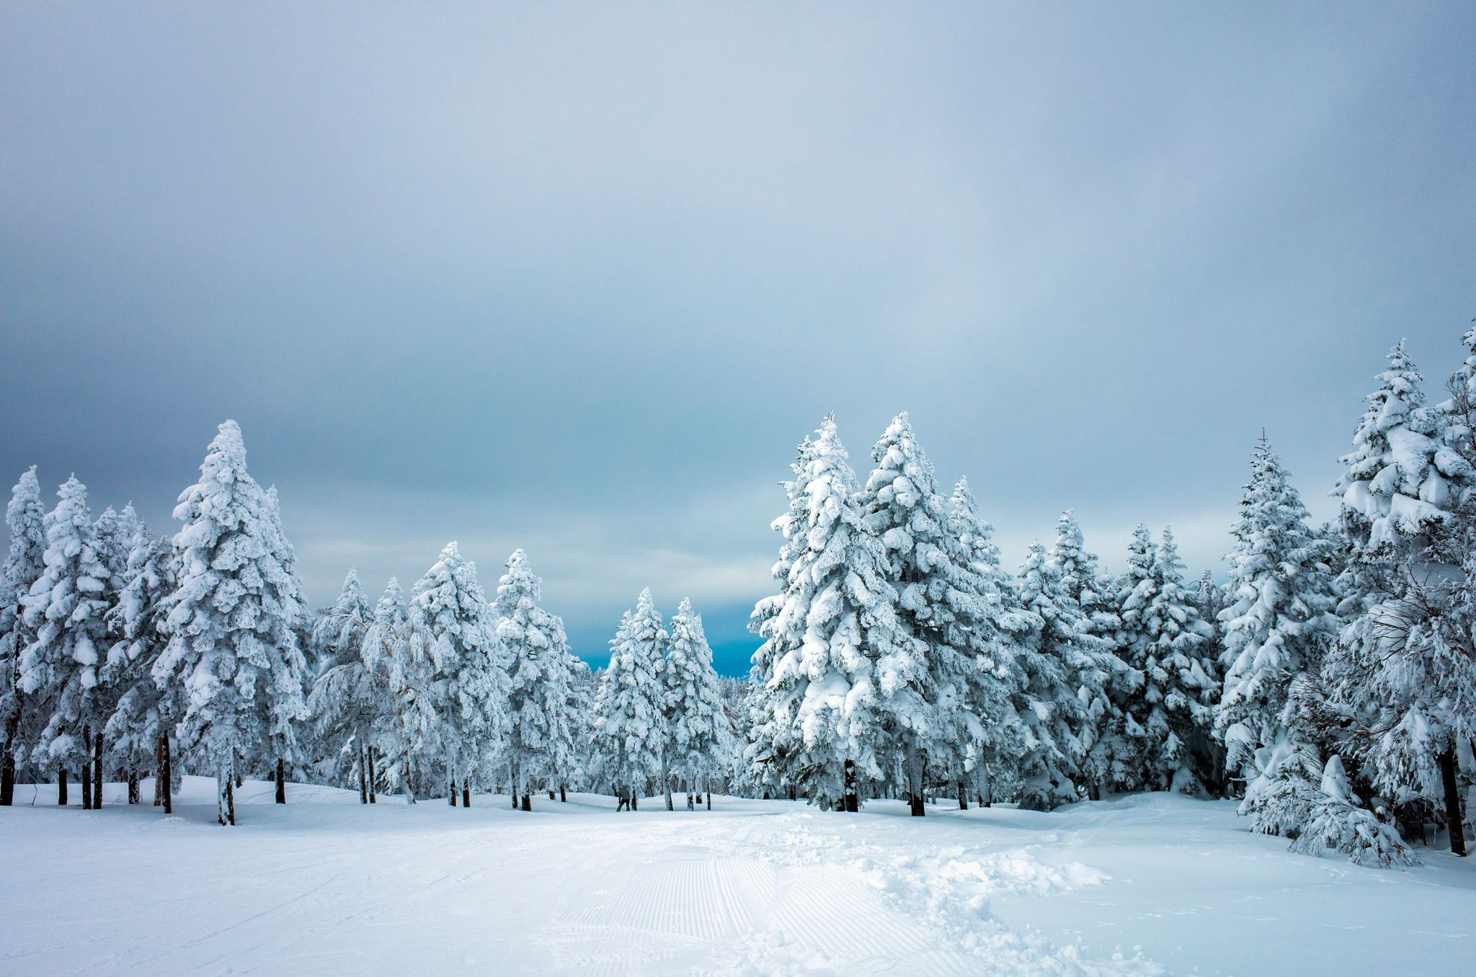

Introduction
Brenna (Mission)
Chelsey (Calgary)
Joscelyne (Whitehorse)
Notes:
Brenna said she could introduce

Slide 3
Wicked Problem
Food Insecurity for Northern Indigenous Communities in Whitehorse, Yukon
What is Food Insecurity
How is this problem unique in Whitehorse
Solutions
Notes:
Brenna: Hello our group is myself Brenna and I live in Mission BC, Chelsey who lives in Alberta and Joscelyne who lives in Whitehorse Yukon. So we are all distant from eachother but this topic can be related to all of our areas.
Our Wicked Problem topic is food insecurity for northern indigenous communities in Whitehorse YT. This wicked problem is quite complex. Food insecurity is the inability to consume or acquire sufficient quality or quantity of food (Health Canada, 2020). The rates for food insecurity for indigenous people in Canada are the highest among developed countries (Thompson et al., 2023). Also due to Yukon unique climate and remote location indigenous communities in Yukon are at an increased risk of experiencing food insecurity ultimate leading to increased risk of disease and poorer health including health outcomes such as obesity diabetes and cardiovascular disease (Blom et al., 2022). There are also quite high food prices that are caused by transportation challenges that can make healthy store bought food unaffordable. Climate change is also one of the aspects that threatens food sources for indigenous communities such as fishing hunting and gathering. Efforts like federal subsidies and trade corridors may lower costs but often threatened indigenous communities right to sovereignty and self governance they may also reinforce dependence on large food imports.
In Whitehorse Yukon there are 14 First Nations, 11 of them are self governing and in 2021 stats Canada said that there was 8811 indigenous people in the Yukon which is 22 3% of the actual population of the Yukon (James-Abra, 2022; Statistics Canada, 2022). Of those 8811 indigenous people Just over 5000 of them live in Whitehorse so a majority of the Indigenous Population (Statistics Canada, 2022). Yukon people suffer from food insecurity at 17% of the population compared to 8.3% of Canada so above the national average (Blom et al., 2022). Yukon First Nations experienced food insecurity due to harsh weather patterns remoteness dependence on food imports limited food production and loss of hunting lands.
The Kwanlin Dün First Nation and Ta’an Kwäch’än (taan quatchin) Council are the Nations that are found in what is colonially known as Whitehorse, Yukon.

Slide 4
Suggested Solutions
Brenna- Community Greenhouses and Indoor Growing Projects
Joscelyne- Nursing advocacy for policy change to increase traditional foods in healthcare
Chelsey- Establishing Community Freezer Programs
Notes:
Brenna: The three solutions that we're going to be talking about include my solution which is community green houses and indoor growing projects, Jocelyn will be talking about nursing advocacy for policy change to increase traditional foods in healthcare and Chelsea will be talking about establishing community freezer programs.
Territory acknowledgment

Slide 5
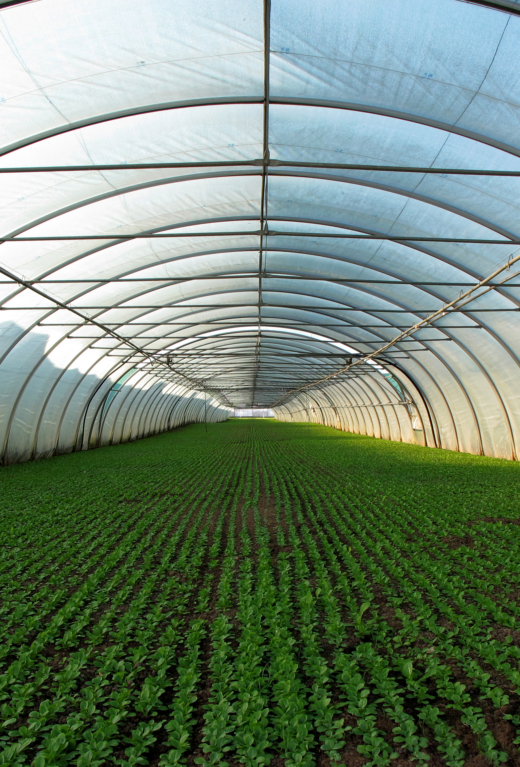
Solution 1- Community Greenhouses and Indoor Growing Projects
Notes:
10 min-1. Innovation and Originality
This solution that I chose is not a new solution. Canada’s Arctic has been using greenhouses and gardens for some time for food procurement. The article I shared is called Greening Canada’s Arctic food system: Local food procurement strategies for combating food insecurity. The article found 36 community gardens and 17 greenhouses across northern Canada (Chen & Natcher, 2019). There are 36 in NWT, 10 in Yukon, three in Nunavut, two in Labrador and two in Nunavik (Chen & Natcher, 2019). The largest greenhouse is 21,600 ft² and located in the Northwest Territories—that is about the size of 1/3 of a football field (Chen & Natcher, 2019). The goal of this solution is to create local, community driven programs that can support Indigenous people to have access to fresh produce year round (with growing and preserving).
2. Description
Produced vegetables include potatoes, carrots, turnips, beets, onions, lettuce, sunflowers, berries, chives, and rice (Chen & Natcher, 2019). Some greenhouse operations are branching out to poultry raising as well (Chen & Natcher, 2019). Beyond food procurement, greenhouses support delivery of training and education on food utilization and storage, food preparation, food safety, nutrition education, food preservation techniques, and cultural revitalization (Chen & Natcher, 2019). This in turn can enhance participants’ wellbeing by decreasing anxiety and feelings of helplessness, providing a social environment and a safe communal space (Ford, Lardeau, & Vanderbilt, 2012 as cited in Chen & Natcher, 2019).
One of the greenhouses is located 15 km from Dawson City, Yukon and is a partnership between Tr’ondek Hwech’in First Nations and Yukon College and produced over 2500 pounds of vegetables in 2015 (Windeyer, 2015 as cited in Chen & Natcher, 2019).
In Inuvik, Northwest Territories, a hockey arena was repurposed into a greenhouse. It has 174 individual plots that can be rented out for an annual fee of $50 (Inuvik Community Greenhouse, 2015 as cited in Chen & Natcher, 2019). Elders are exempt from this fee. This greenhouse receives funding from the Government of Canada, Government of the Northwest Territories, Conoco Phillips, and Shell Canada (Public Health Agency of Canada, 2019 as cited in Chen & Natcher, 2019). Other than the individual lots, the upper floor consists of a commercial greenhouse and is used to offset the operational costs (Public Health Agency of Canada, 2009 as cited in Chen & Natcher, 2019).
There are multiple other operations mentioned in the article. Some, like the Nunavik one, have been operating for over 20 years between May and October. Some have their own composting and seed preparation areas.
3. Rationale and Strength of Solution
There is limited research on the actual impact that community gardens and greenhouses have on alleviating food insecurity in northern Canada, but the bit of research that exists suggests there is value in it—not only for food production but also for providing community development, training, and education (Chen & Natcher, 2019). I think the fact that the one has been operating for 20 years that speaks for itself. The Government of Canada (2023) has announced in June of 2023 that there will be five new Indigenous led projects that study food security in northern communities.
Community and school greenhouse projects could support local food sourcing. Indigenous people continue to source food from two interactive systems: traditional and market. In some climates, fresh fruit and vegetables cannot grow for many months of the year. The loss of traditional lands may also contribute to not having enough harvestable substances to feed a family over the winter. Gardening without a greenhouse in northern communities can be difficult due to climate extremes, inadequate soil, permafrost, and shorter growing seasons.
This isn’t a new solution for food procurement in the North, but expanding it to include a greater use of it in Whitehorse specifically for Indigenous communities would be great. Yukon producers have utilized greenhouses to aid in vegetable and flower production.
This option could create strengths for an Indigenous community by supporting food sustainability, education, and community resilience. This would support Indigenous food sovereignty.
4. Implementation and Challenges
Partnering with the local First Nation community members would be the first step in creation of this idea. Assessing the community readiness for this type of project would be important. Possibly something like the community readiness survey that was completed for the Inuvik Northwest Territories, one of the questions was “Very fresh fruits and vegetables are not usually available for me to buy” which was marked 70% Strongly agreed or agreed (Sellwood & Dutton, 2016). Making sure this is something that would suite the First Nation people in Whitehorse. This would be followed by gathering funding options such as grants and possibly suggesting additional funds to already funded programs. The design would then need to be modeled after successful northern greenhouses, and staff or community members would need to be trained on how to maintain, harvest, and propagate the produce.
Some of the considerations include how the greenhouse will be constructed. There are different options such as a polycarbonate greenhouse that would fare better in a colder climate, heater fans powered by propane to move around air, and hydroponic type greenhouses that don’t require fertile soil. Other considerations include the seasons it could be used in, sustainability (including the ability to preserve goods via canning and seed saving), and water usage. There are also geothermally heated greenhouses, vertical farming, and aquaponic greenhouse that could be optimized (Blom et al., 2022). Geothermal heated greenhouses rely on natural heating sources, hydroponics make it possible to grow without soil, aquaponics are a closed loop water system that combines aquaculture (pond life/fish production) and hydroponics (Blom et al., 2022).
There are also organizational questions: who would manage the garden—community members on a schedule, or one designated person? Who owns the greenhouse? How to get funding for it—through grants, the First Nation, or repurposing materials?
Some challenges include finding willing support to help maintain the greenhouse or garden, funding for regular maintenance (for example, if the watering system needed repair or replacement), and land ownership or placement, which could be difficult to navigate as well.
An innovation that was used in Inuvik was the development of the Autumn Delight apple, which was developed at the University of Saskatchewan (Deobald, 2024). It took 30 years of studying and grafting apple trees to cultivate varieties that can withstand the climate of Northern Canada (Deobald, 2024).
5. Feasibility and Recommendations
The Yukon greenhouse industry grew by 63 per cent since 2016 (in terms of floor area) to a total of over 5,200 m², while the number of farms with greenhouses shrunk by a third (Government of Yukon, 2023). There has been a substantial increase in greenhouse space being used to cultivate non-edible crops such as ornamental tree seedlings, cuttings, bedding plants, transplants, or plugs.
There is one large-scale greenhouse business located in Whitehorse selling vegetables, fruits, flowers, and ornamental plants that likely account for the majority of the crop area reported by Statistics Canada (Government of Yukon, 2023). In 2022, the Federal government invested in a passive solar greenhouse in Whitehorse that is about 1,800 m² and supplies local grocery stores with produce. This decreases costs for public purchasing but is in very limited volumes (Government of Yukon, 2023). They can sell this produce at a much lower cost than the imported produce at the grocery store.
The Indigenous-specific greenhouse could use the model of the Nunavik greenhouse that has been sufficient for 20 years; it would just need a larger scale. Local food production could reduce reliance on imported produce, and preservation could allow for vegetables all year long.
There is a government program called Nutrition North Canada that provides subsidies and other programming such as food harvesting grants for nations experiencing food insecurity. Maybe this could be expanded to include funds and grants to start up and maintain community gardens. There could also be standardized plans available, so communities aren’t starting from scratch or relying on trial and error. More research would be needed to identify the feasibility of this solution. Since the population is growing, and many already suffer with food insecurity, the need to produce more food should be addressed through environmentally friendly methods if possible, such as greenhouses and vertical farms as well (Vatistas et al., 2022).

Slide 6
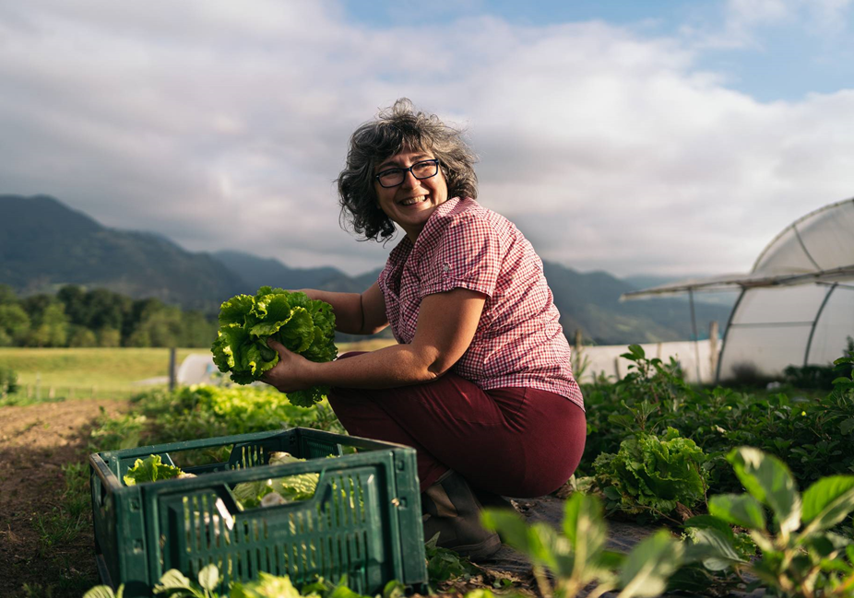
Community Greenhouses and Indoor Growing Projects-Brenna
Innovation and Originality
Descriptions and Examples
Rationale and Strengths
Implementation
Challenges
Feasibility
Recommendations

Slide 7
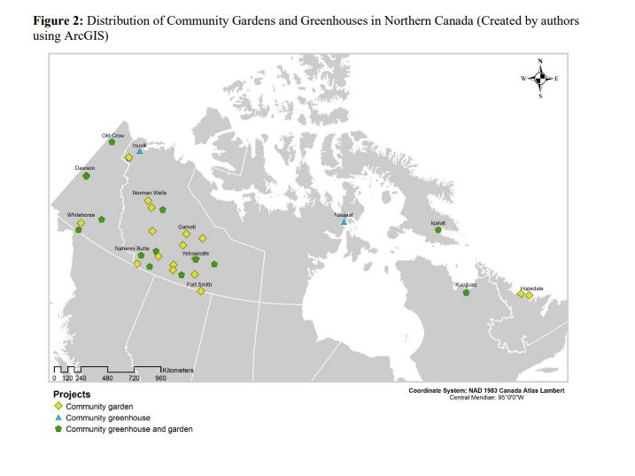
Map of Greenhouses and Gardens In Northern Canada
(Chen & Natcher, 2019)

Slide 8
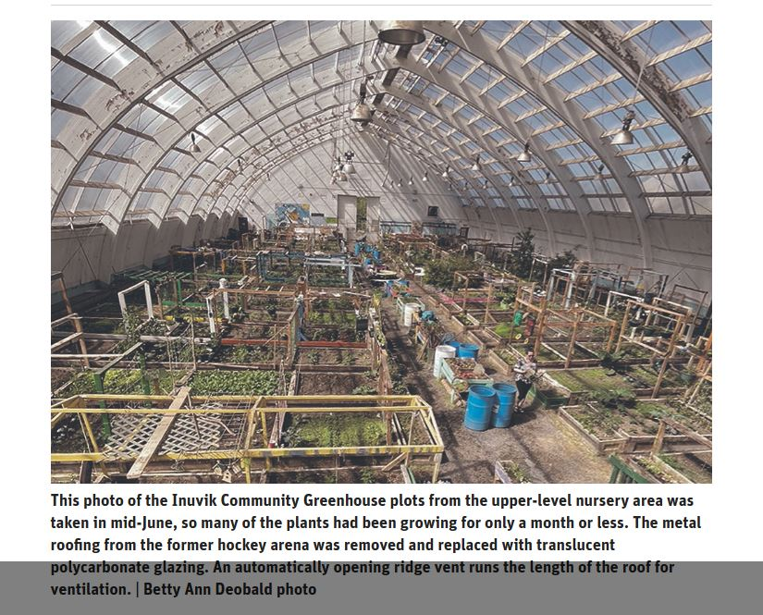
Inuvik Greenhouse/ Arena
(Deobald, 2024)

