Slide 1
Food Insecurity for Northern Indigenous Communities in Whitehorse, Yukon
Brenna Bull, Chelsey Jeffrey and Joscelyne Bergen
HLTH 5200: The Canadian Health Care System
Dr. Anila Virani
November 5, 2025

Slide 2

Suggested Solutions
Brenna- Community Greenhouses and Indoor Growing Projects
Joscelyne- Nursing advocacy for policy change to increase traditional foods in healthcare facilities
Chelsey- Establishing Community Freezer Programs

Slide 3

Solution 2- Nursing advocacy for policy change to increase traditional foods in healthcare facilities
Notes:
-I will be talking about my solution of Nursing Advocacy for policy change to increase traditional foods in healthcare facilities.
(Description)
I would like to start with a story which inspired this solution. I work at the Kwanlin Dun First Nation Health Centre in Whitehorse, which serves one of the local First Nations. We often have donations of wild game for our food programs. The donation process is regulated through Yukon Environmental Health Services, to ensure the safety of the food being served (Yukon Government, 2024). There are a few different forms to fill out and certain butchers that must be used in order to donate meat (Yukon Government, 2024). This September we had local citizens who had a successful moose hunt and were looking to donate the organs, which are a delicacy to many, especially the Elders. We were unable to accept the organs as the policies were vague the definition of meat is. It has been taught to me by my Elders that when we hunt or gather, we use all parts of the plants or animals that we have harvested. The plant or animal has given its life for us, and we must respect that in return.
(Innovation & Originality)
In terms of innovation, the First Nations Health programs located in Yukon Hospitals, long term care facilities and health centres are pretty robust, but most of the policies talk about "meat" and not the rest of the animals that we use and eat, as well as small game such as beaver, grouse, rabbit. At the hospital they are able to serve traditional foods daily, mostly through the donation programs (Yukon Hospital Corporation, 2025). Therefore, nurses advocating for policy change to increase traditional foods in healthcare facilities is not a novel solution. There are many healthcare facilities in the Yukon and across Canada that include traditional food on the menu, what is needed is modifications to the current policies to allow for consistency of access to traditional food in all healthcare facilities and less restrictions to allow for a variety of local wild game and all components of the wildgame to be used. Food insecurity can be linked to colonization, the colonial legislation such as the Indian Act, Residential school history which banned cultural food harvesting and feasting (Fournier et al., 2019); nurses advocating for policy changes within healthcare facilities to include more traditional food can be one step of reconciliation towards decolonization of healthcare policies and a modification to current solutions. As Indigenous advanced practice nurses, it is vital for us to realise that we need to amplify our professional voices to increase culturally safe policies and care for all Indigenous people in the North and across Canada (Brockie et al., 2023).

Slide 4
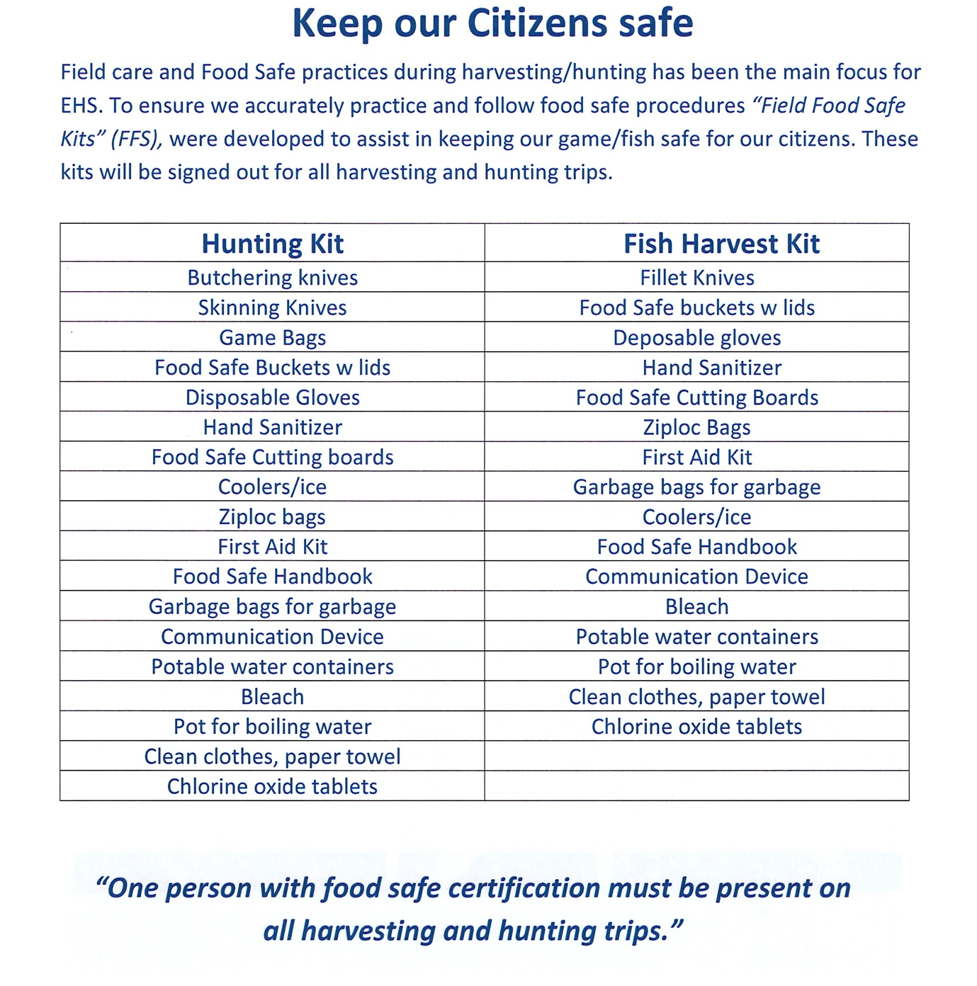
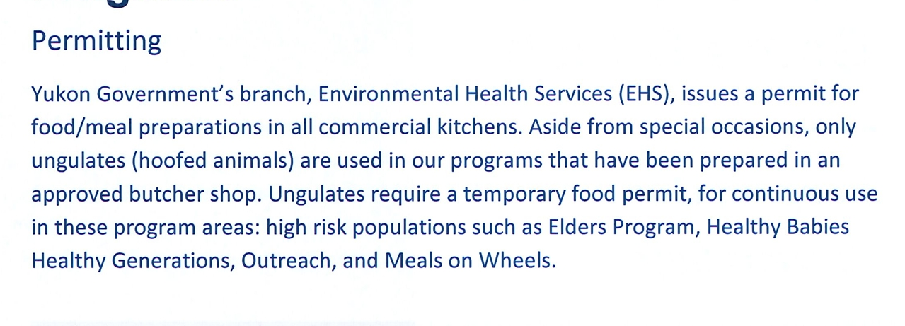













(Kwanlin Dun First Nation, 2022)
Notes:
This is an example of one of the guideline documents from our food policy at the Health Centre. You can see that it specifies only ungulate (like moose) meat from approved butchers.
To the right, you see the hunting/fishing kits that they expect citizens to hunt with. Items such as bleach, chlorine oxide tablets, Food safe manuals-all items that my family personally doesn't hunt with. Also, the specification that one person needs Food safe.

Slide 5
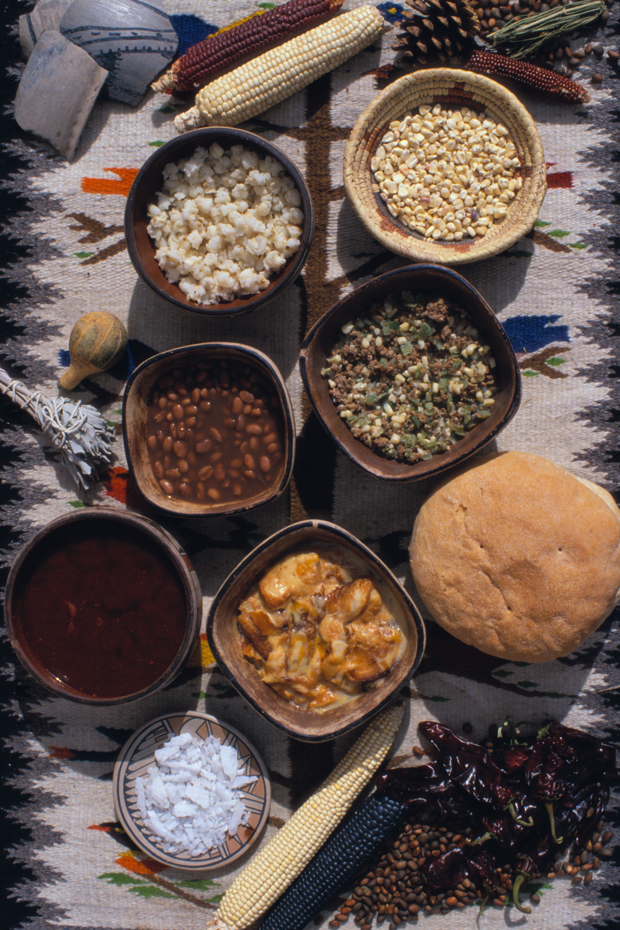
Solution 2
Importance of policy advocacy
Importance of access to traditional food
Supporting documents
Notes:
(Rationale/Description)
It is important to advocate for policy change with Indigenous communities to decolonize health care and improve community health (Fournier et al., 2019). Within the policy changes it is important to ensure that local and traditional food sources are implemented for consumption, to help to decrease the prevalence of chronic diseases that may be caused by an unhealthy diet (Fournier et al., 2019). As advanced practice nurse leaders, we need to advocate for policy change within our communities (Chiu, 2019). Policy advocacy is an expectation of our profession. When we advocate with united voices we have the ability to improve global health (Chiu, 2019).
I have been taught growing up that food is medicine, and have been privileged to have traditional food as part of my life. It is imperative to have traditional food available in health care facilities, as it contributes to the ability to wholistically heal patients and contribute to culturally safe care (Conklin et al., 2025). The First Nation Health Program at Yukon Hospital Corporation serves large wild game (moose, caribou, etc.) (Yukon Hospital Corporation, 2022). This is why I think that nurses advocating for policy change is not a novel solution idea even locally to the Yukon, but rather that we are needing to make modifications and use our nursing voices to advocate for more Indigenous inclusive policies which would include all parts of the plant or animal being used. The pre-reading video by Ontario Fresh (2019) was a great short documentary in describing Indigenous Hospital Food programs, and what it looks like to have all team members and stakeholders working together to advocate for culturally safe hospital care. As a nurse, I understand the importance of having food regulations, but as an Indigenous nurse, I see the harm in colonial policies which are wasting food and denying people their right to traditional food. These colonial policies contribute to the prevalence of food insecurity especially in Northern Indigenous Communities (Conklin et al., 2025).
As nurse leaders, if you are unsure of documents that can support your policy advocacy, the Truth and Reconciliation Commissions: Calls to Action (2015) is a good start. Call 22 states "We call upon those who can effect change within the Canadian health-care system to recognize the value of Aboriginal healing practices and use them in the treatment of Aboriginal patients in collaboration with Aboriginal healers and Elders where requested by Aboriginal patients" (Truth and Reconciliation Commission, 2015, p.3). Remember food is medicine and culture, and it has healing properties (Conklin et al., 2025). If we have the knowledge to use our voice, then it is within our professional responsibilities to use it (Yukon Registered Nurses Association, 2019).

Slide 6
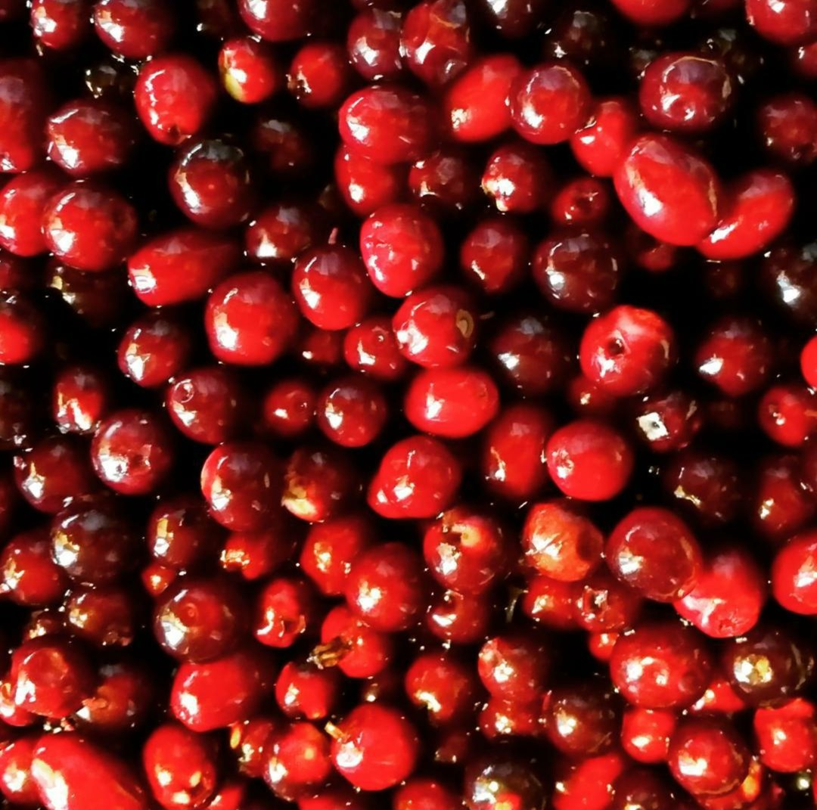
Solution 2
Strengths
Implementation
Feasibility
Notes:
(Strengths)
The first strength is that advocacy is a skill that we possess as nurses. Nurses are expected to advocate for health policy that would be in the best interest of our patients and communities (YRNA, 2019;). Therefore, advocating for policy change should be an inherent strength that we all possess as nurses. As nurses who have chosen to pursue graduate education and strengthen our leadership skills, we must take the time to educate ourselves on important health issues and advocate for them. We need to remember that the public trusts nursing as a profession, and that our voice carries merit no matter the leadership role that we are in, but it can be stronger as collective nursing bodies (Villeneuve, 2020).
The second strength is that this solution will increase our knowledge and cultural competence. When we view food as medicine and culture, we realise the importance of advocating for nutrition policy change within health care facilities (Conklin et al., 2025). It is essential to remember that we cannot pan-Indigenize healthcare menus across Canada, we can advocate for local less restrictive policy change, but is crucial to remember that traditional food may vary region to region and nation to nation (Conklin et al. 2025). An example of this would be Coastal nations consuming more seafood, and the Yukon having less access to seafood beyond fish.
A third strength is that this solution is not costly initially. It is a matter or combining the first two strengths together, to support our community.
(Implementation)
2) In terms of implementation, initially advocating for policy change would take nothing more than our valuable nursing time, both to research and convince the governments necessary to change policies. Once the change is approved, the implementation may become more time consuming and costly. Personally I would start small scale on this and seek input from the community. Then if it is successful at a smaller scale, start branching out towards larger populations. This is when community led research may come into play as well, as a way to gather data and prove that changes to policy are needed (Lin et al., 2020). As an update since September, my small Health Centre has verbally had its policy changed to allow us to accept organs if they are donated. This is a benefit of working for a Self-Governing First Nation, what this means is that the Nation creates its own laws and policies under a Self-Governing agreement with the Federal Government (Government of Canada, 2024). While the health centre has changed this policy (I will also add in unofficially, as the formal policy is not yet amended), this change has not yet reached the other local health care facilities. The video that was given as a pre-reading highlights the importance of all key stakeholders working together to support policy change, and that is why they are the only health care facility in Canada that can serve unregulated meat.
One challenge that can be anticipated with this implementation, would be implementing the policy change across the Territory, as there are a few different stakeholders at play. The stakeholders may also have differing views. The largest stakeholder who would have firm views is Yukon Environmental Health Services, as they are the branch concerned about food health, preparation and serving. From what I have noticed so far in my nursing career, large scale policy changes are a difficult process with many steps and are time consuming.
(Feasibility)
Based on the information that I have shared today, I feel that this solution is very feasible. It is very possible for us to use our nursing voice to strengthen the needs of the community. While it may not always be successful, even small changes are a win. The biggest risk for this from a health care standpoint would be food borne illness if unregulated meats are served. With FoodSafe and culinary training, that could add some education to cooks who may be preparing the food. This is also why intergenerational learning remains important, as our Indigenous communities have ways to prepare food in safe ways which outdate government regulations. A large portion of that knowledge has been lost to colonization (Conklin, 2025).
Thank you for listening to my solution.
9 min 30 sec

Slide 7
Thank you
Questions?

